Slide 1
Economic Theory
Laba Kumar Shrestha (Lecturer)
Patan Multiple Campus

Slide 2
Background
Adam Smith, 1776 AD
Book published by Adam Smith on 1776 AD titled as “An enquiry into the nature and causes of wealth of nation”
Economics is the science of wealth” It deals with production, distribution, and consumption.
a) Political Economics b) Laissez Faire (Free market economy)
Malthus ( Theory of Population)
Ricardo ( Theory of Rent)
Economic Thinking i) Ancient economic thoughts (2500 BC to 475 AD) - Hebrews, Greek, Roman, Hindu, Buddhist ii) Medieval Economic Thoughts (476 AD to 1453 AD) iii) Mercantilism iv) Physiocrats v) Adam Smith, 1776 AD vi) Alfred Marshall, 1890 AD vii) Lionel Robbins, 1923 AD

Slide 3
Alfred Marshall, 1890 AD
Book Published by Alfred Marshall titled as “Principles of Economics”
Definition of Economics as per Alfred Marshall- “ Economics is a study of mankind in the ordinary business of life. It examines that part of individual’s and social actions which is most closely connected with the attainment and with the use of material requisites of well being.
Economics studies that portion of the personal and social activities, which are closely related to the attainment of material resources, related to welfare and its utilization .
Economics studies all the actions that people take in order to achieve economic welfare because man earns money to get material welfare.” Economics is the study of humans, in relation to the ordinary business of life.”
Lionel Robbins, 1923 AD
Book Published by Lionel Robbins titled as “Principles of Economics” and “Essay on Nature and significance of economic science” 1932 AD
Definition of Economics as per Lionel Robbins- “Economics is the science which studies human behavior as a relationship between end and scarce means, which have alternative use.”
a)Unlimited Wants b) Scarce Means
c) Alternative Use of Scarce d) Means Variation in the Intensity of wants

Slide 4
General Definition of Economics
Economics is a social science concerned with production, distribution and consumption of goods and services.
It studies how individuals, businesses, governments and nations make choice about how to allocate resources. Economics is a science which study that how people allocate scarce resources for production, distribution and consumption both individually and collectively. In simple language the economics is a science which is use to determine effective use of resources to meet private and social goals. It is concerned with Production and employment, investment and savings, health, money and the banking system, government policies on taxation and spending, international trade, industrial organization and regulation, urbanization, environmental issues. These are just a sampling of the concerns at the heart of the science of economics.
Definitions of Micro economics
The modern approach divides the subject matter of economics in to two broad inter dependent branches. These terms are first use by professor Ragner Frisch. That is Micro Economics And Macro Economics
Microeconomics deals with a small part or Small component of the national economy of a country. It is the study of economic actions of individuals and small group of individuals. Microeconomics may be defined as that branch of economic analysis which studies the economic behavior of individual units, may be a person ,a particular household, or a particular Firm. It is a study of one particular unit rather than all the units combined together.

Slide 5
According to G Ackley “ Micro economics deals with the division of total output among industries products , firms and allocation of resources among competing groups”
According to Boulding ‘’ Microeconomics includes the study of particular household, individual price, wage, income, industry particular commodities etc”
Scope or Subject matters of Microeconomics
Theory of Demand
Theory of production
Theory of Product pricing
Theory of factor pricing
5) Theory of welfare Economy
Types of Microeconomics
A) Micro statics
B) Comparative Micro Statics
C) Micro Dynamics

Slide 6
Economic System
The economic activity such as production takes place at several economic institutions such as schools, hospitals, factories, mines, shops, banks cinema houses, workshops, government and private offices, farms, etc. All these economic activities (such as production, distribution, consumption, investment) by the economic institutions that produce income for the people involved are collectively known as an economy.
Just like a machine or a human body (as a system) is made up different parts that perform specific functions, an economy is also made up of different part, which has different functions, due to which an economy is called an ‘economic system’. An economy as a ‘system’ is made up of different organs like producers (production), distributors (distribution), consumers, investors (investment), entrepreneurs, etc. perform different functions and work together, just like a system is made up of different organs and when any one of the organ dysfunctions, then the whole system collapse or does not exist.
In short ,”An economic system is a particular setoff social institutions which deals with the production, distribution, consumption, of goods and services.”
A) Capitalist Economy Or Market Economic System
B) Socialist Economy Or Planned Economic System
C) Mixed Economy Or Mixed Economic System

Slide 7
Capitalist Economy Or Market Economy
Capitalism is an economic system in which private individuals or businesses
own capital goods. The production of goods and services is based on supply and demand in the general market-known as a market economy-rather than through central planning-known as a planned economy or command economy.
The purest form of capitalism is free market or laissez-faire capitalism. Here, private individuals are unrestrained. They may determine where to invest, what to produce or sell, and at which prices to exchange goods and services. The laissez-faire marketplace operates without checks or controls.
Capitalist Economic System
i) Production is carried out to maximize private profit.
ii) Decisions regarding investment and the use of the means of production are determined by competing
business owners in the marketplace.
iii) Production takes place within the process of capital accumulation.
iv) The means of production are owned primarily by private enterprises decisions regarding production and
investment determined by private owners in capital markets.
Characteristics of a Capitalist Or Market Economy
a) Private property b) Free competition c) Right of Inheritance d) Freedom of occupation And enterprise
e) Price mechanism f) Profit Motive g) Self interest h) Freedom of choice for consumer
i) Minimum government intervention j) Individual property and economic growth k) Decentralizations on economic decision

Slide 8
Socialism or Command economic system
In a command system, there is a dominant, centralized authority –usually the government – that controls a significant portion of the economic structure. The government comes in and exercises control over the resources. Centralized control covers valuable resources . The people regulate other less important sectors of the economy, such as agriculture.
Command economies are rigid compared to other systems. They react slowly to change because power is centralized. That makes them vulnerable to economic crises or emergencies, as they cannot quickly adjust to changed conditions
A centrally planned economy, also known as a command economy, is an economic system in which a central authority, such as a government, makes economic decisions regarding the manufacturing and the distribution of products. Centrally planned economies are different from market economies, in which such decisions are traditionally made by businesses and consumers.

Slide 9
The production of goods and services in command economies is often done by state-owned enterprises, which are government owned companies. In centrally planned economies, which are sometimes referred to as "command economies", prices are controlled by bureaucrats In a command system, there is a dominant, centralized authority –usually the government – that controls a significant portion of the economic structure. The government comes in and exercises control over the resources. Centralized control covers valuable resources . The people regulate other less important sectors of the economy, such as agriculture. Command economies are rigid compared to other systems. They react slowly to change because power is centralized. That makes them vulnerable to economic crises or emergencies, as they cannot quickly adjust to changed conditions
Characteristics of a Socialist Economy planned economy i) Ownership by government
ii) Decisions on what to produce, how to produce and how to distribute goods taken at national bureaucratic level
iii) Prices usually set by price controls rather than market forces.
iv) Distribution according to ration books.
v) Production could be planned for five or ten years in advance
vi) Requires more levels of bureaucracy to manage and plan economic decisions
vii) Scope for inefficiency is less due to lack of incentive
viii) Often required degree of political control and censorship

Slide 10
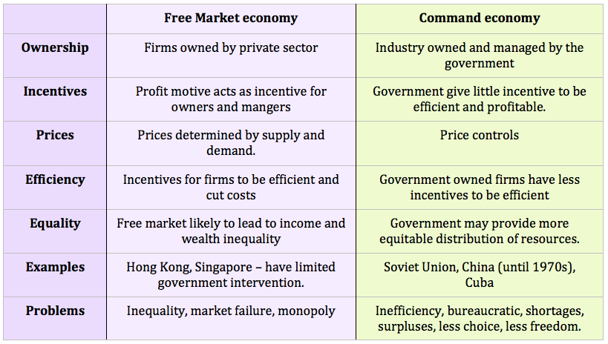

Slide 11
Mixed Economic system
A mixed economic system is a system that combines aspects of both capitalism and socialism. A mixed economic system protects private property and allows a level of economic freedom in the use of capital, but also allows for governments to interfere in economic activities in order to achieve social aims.
Mixed systems combine the characteristics of the market and command economic systems. It is also known as dual systems. Sometimes the term is used to describe a market system under strict regulatory control.
Most industries are private, while the rest, comprised primarily of public services, are under the control of the government.
A mixed system combines the best features of market and command systems. However, practically speaking, mixed economies face the challenge of finding the right balance between free markets and government control. Governments tend to exert much more control than is necessary

Slide 12
Main characteristics of Mixed Economy
> Coexistence of private and public sector
> Cooperative sector (government can provide financial assistance to co operatives societies involved in warehousing , agriculture, dray industry)
> Freedom and Control
(In mixed economy all individuals have freedom of produce goods, hold private property, choose occupation and choose products and occupation as they want. But to keep a check on monopoly practicies and discrimination of the backward sector of society the state maintain some control.)

Slide 13
Production Possibilities Curve
Production Possibility Curve (PPC) is a graphical representation of all the possible combinations of two goods that can be produced by the optimum (fuller) utilization of available resources and the given technology. It gives us the maximum limit of goods and services that could be produced. It gives us the maximum limit of goods and services that could be produced. So, it is also known as the production possibility boundary or production possibility frontier (PPF).
Production Possibility Curve (PPC) is the locus (the path of a moving point) of various combinations of two commodities which can be produced with given level of resources and technology. It is also known as transformation curve. Given fixed constraints of production factors, the production possibilities curve shows the possible combinations of production volume for two goods in question
A production possibilities curve in economics measures the maximum output of two goods using a fixed amount of input. The input is any combination of the four factors of production: natural resources (including land), labor, capital goods, and entrepreneurship. By describing this trade-off, the curve demonstrates the concept of opportunity cost. Making more of one good will cost society the opportunity of making more of the other good
.
The assumption is that production of one commodity decreases if that of the other one increases, given the finite resources or inputs available for use.
The production possibilities curve is also called the PPF or the production possibilities frontier

Slide 14
The PPF simply shows the trade-offs in production volume between two choices. All choices along the curve shows production efficiency of both goods. Production points inside the curve show an economy is not producing at its comparative advantage. Conversely, production outside the curve is not possible as more of both goods cannot be produced given the fixed resources.
In short, production–possibility frontier (PPF), production possibility curve (PPC), or production possibility boundary (PPB), or Transformation curve/boundary/frontier is a curve which shows various combinations of the amounts of two goods which can be produced within the given resources and technology/a graphical representation showing all the possible options of output for two products that can be produced using all factors of production, where the given resources are fully and efficiently utilized per unit time. A PPF illustrates several economic concepts, such as allocative efficiency, economies of scale, opportunity cost (or marginal rate of transformation), productive efficiency, and scarcity of resources
PRODUCTION POSSIBILITIES SCHEDULE
A table of numbers that illustrates the production possibilities of an economy--the alternative combinations of two goods that an economy can produce with given resources and technology. A production possibilities schedule illustrates that the economy must give up the production of one good to produce another good--the basic economic notion of opportunity cost. A production possibilities schedule is also used to derive the highly useful production possibilities curve (or frontier).

Slide 15
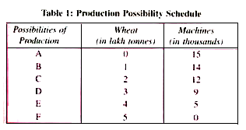
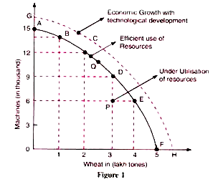
Production Possibility Schedule(PPS) and Curve (PPC)

Slide 16
Utility
Utility is the total satisfaction or benefit derived from consuming a good or service. it is a term used to determine the worth or value of a good or service. Utility of a commodity is its want-satisfying capacity. The more the need of a commodity or the stronger the desire to have it, the greater is the utility derived from the commodity. Utility is subjective. Different individuals can get different levels of utility from the same commodity. On the other hand Utility is that one individual gets from the commodity can change with change in place and time.
There are two types of Utility Analysis
a) Cardinal Utility Analysis
b) Ordinal Utility or Indifference Curve Analysis
The Cardinal Utility approach is propounded by neo-classical economists, who believe that utility is measurable, and the customer can express his satisfaction in cardinal or quantitative numbers, such as 1,2,3, and so on.
The neo-classical economist developed the theory of consumption based on the assumption that utility is measurable and can be expressed cardinally called as “Utils” meaning the units of utility.
The cardinal utility approach used in analyzing the consumer behavior depends on the following assumptions
i) Rationality ii) Resources (Money) are Limited iii)Maximize Satisfaction iv)Utility is cardinally Measurable
v) Diminishing Marginal Utility v) Marginal Utility of Money is Constant vi) Utility is Additive

Slide 17
:
Rationality: It is assumed that the consumers are rational, and they satisfy their wants in the order of their preference. This means they will purchase those commodities first which yields the highest utility and then the second highest and so on.
Limited Resources (Money): The consumer has limited money to spend on the purchase of goods and services and thus this makes the consumer buy those commodities first which is a necessity.
Maximize Satisfaction: Every consumer aims at maximizing his/her satisfaction for the amount of money he/she spends on the goods and services.
Utility is cardinally Measurable: It is assumed that the utility is measurable, and the utility derived from one unit of the commodity is equal to the amount of money, which a consumer is ready to pay for it, i.e. 1 Util = 1 unit of money.
Diminishing Marginal Utility: This means, with the increased consumption of a commodity, the utility derived from each successive unit goes on diminishing. This law holds true for the theory of consumer behavior.
Marginal Utility of Money is Constant: It is assumed that the marginal utility of money remains constant irrespective of the level of a consumer’s income.
Utility is Additive: The cardinalists believe that not only the utility is measurable but also the utility derived from the consumption of different commodities are added up to realize the total utility.

Slide 18
Measures of Utility
Total Utility: Total utility of a fixed quantity of a commodity (TU) is the total satisfaction derived from consuming the given amount of some commodity x. More of commodity x provides more satisfaction to the consumer. TU depends on the quantity of the commodity consumed. Therefore, TUn refers to total utility derived from consuming n units of a commodity x.
Marginal Utility:-Marginal utility (MU) is the change in total utility due to consumption of one additional unit of a commodity. For example, suppose 4 bananas give us 28 units of total utility and 5 bananas give us 30 units of total utility. Clearly, consumption of the 5th banana has caused total utility to increase by 2 units (30 units minus 28 units). Therefore, marginal utility of the 5th banana is 2 units. MU5 = TU5 – TU4 = 30 – 28 = 2 In general, MUn = TUn – TUn-1, Table and Figure show an imaginary example of the values of marginal and total utility derived from consumption of various amounts of a commodity. Usually, it is seen that the marginal utility diminishes with increase in consumption of the commodity. This happens because having obtained some amount of the commodity, the desire of the consumer to have still more of it becomes weaker.
Law of Diminishing Marginal Utility
Law of Diminishing Marginal Utility states that marginal utility from consuming each additional unit of a commodity declines as its consumption increases, while keeping consumption of other commodities constant. In given Figure and table MU becomes zero at a level when TU remains constant. In the example, TU does not change at 6th unit of consumption and therefore MU6 = 0. Thereafter, TU starts falling and MU becomes negative.

Slide 19
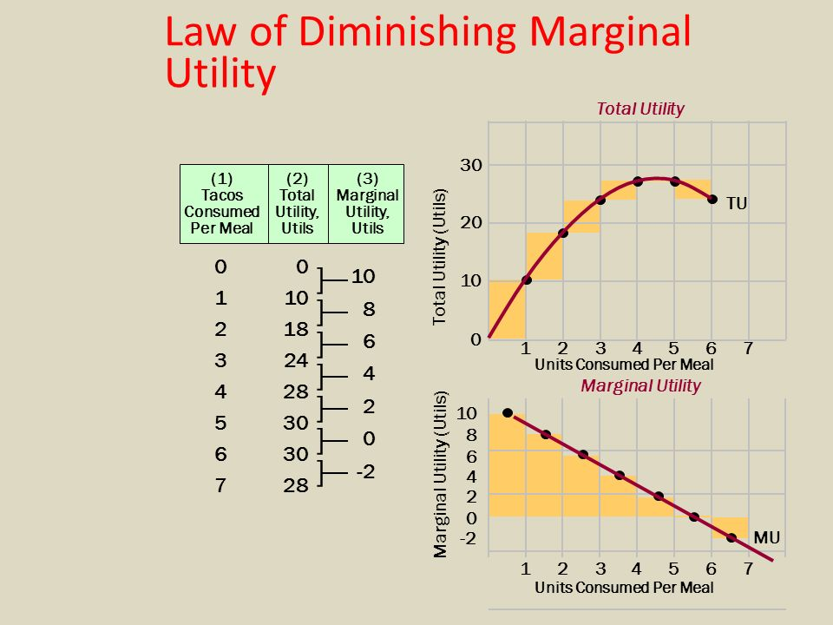
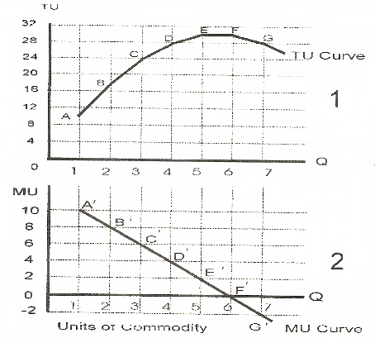
Law of Diminishing Marginal Utility
Quantity | Total Utility | Marginal Utility
1 | 10 | 10
2 | 18 | 8
3 | 24 | 6
4 | 28 | 4
5 | 30 | 2
6 | 30 | 0
7 | 28 | -2

Slide 20
Law of equi-marginal utility
The equi-marginal principle is based on the law of diminishing marginal utility. The equi-marginal principle states that a consumer will be maximizing his total utility when he allocates his fixed money income in such a way that the utility derived from the last unit of money spent on each good is equal. In other words, consumer is in equilibrium position when marginal utility of money expenditure on each goods is the same.
Now, the question is how he would allocate his money income among various goods that is to say, what would be his equilibrium position in respect of the purchases of the various goods. It may be mentioned here that consumer is assumed to be ‘rational,’ that is, he coldly and carefully and substitutes goods for one another so a s to maximize his utility or satisfaction.
In short, the law of equi­-marginal utility tells us the way how a consumer maximizes his total utility.
.

Slide 21
Consumer's Equilibrium
The Cardinal approach to Consumer Equilibrium posits that the consumer reaches his equilibrium when he derives the maximum satisfaction for given resources (money) and other conditions. A consumer is said to be highly satisfied when he allocates his expenditure in such a way that the last unit of money spent on each commodity yields the same level of utility. Suppose a consumer with a given amount of resources (money) consumes a single commodity, say X. For a consumer, both his income and commodity X will have respective utilities and he can either retain his income in the form of asset or can exchange it for the commodity X. If the marginal utility of commodity X (MU_{x}) is greater than the marginal utility of money (Mu_{m}), then a utility-maximizing consumer will exchange his money income for a commodity
Assumptions of the Law
i) A consumer has many wants. v) The consumer has a fixed income.
ii) The utility is measurable in cardinal terms. vi) The marginal utility of money is constant
iii) There are substitutes for goods vii) Consumer tries to have maximum satisfaction
Price of the goods or services are Constant. viii) A consumer has perfect knowledge of utility and price
of the goods.

Slide 22
. Based on the assumption, the marginal utility of a commodity is said to be declining with each successive unit and whereas the marginal utility of money remains constant, therefore the consumer will spend his money income on commodity X as long as MU_{x} > P_{x}(Mu_{m}). The Px is the price of the commodity and Mu_{m} is equal to one.
Thus, the consumer reaches his equilibrium when,
Mux = Px (Mum) or Mux / Px = Mum
As per the given graph, P_{x} (Mu_{m}) is the horizontal line which shows the constant utility of money, whereas the MUx is a downward sloping curve which shows the diminishing marginal utility of commodity X. The P_{x}(Mu_{m}) line and Mu_{x} curve intersect at point E, which indicates that at quantity OQ_{x}, MU_{x} = P_{x}(Mu_{m}). Therefore, the consumer is said to be in equilibrium.
Any point above E, let’s say at M, the MU_{x} > P_{x}(Mu_{m}) the consumer will exchange money for commodity X since the marginal utility of the commodity is greater than the marginal utility of money, his satisfaction level will increase. Whereas any point below the equilibrium point “E,” the consumer loses utility and hence can compensate by reducing his consumption of commodity X.

Slide 23
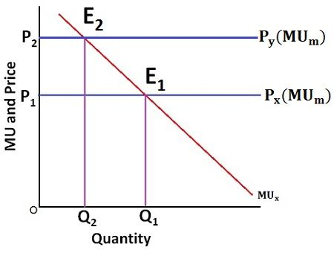
Units MU X Total U
1 30 30
2 25 55
3 20 75
4 10 85
5 0 85
6 -5 80
Suppose Mum One unit of money = 20 utils ,
Price of X= 1unit of money, consumer has 5 units of money
Consumer will spent 3units of money and get maximum satisfaction
where Mum=20 and Mu of 3rd X=20 or MUX= Mum
Total utility became 115 utils,
Equilibrium of Consumer=Mux = Mum,
Or Consumer equilibrium = Mux/Px = Muy/Py = Mum

Slide 24
Numerical Example Of Equi-marginal Utility
If Price of X Y Z are same 1Rs per each and MU of goods XYZ are as the schedule. If MUm of money is 12 for Ram ,he will buy 2 units of X, 3 units of Y and 4 units of Z, and get total utility=152
[ (15+12=27from X),(18+14+12=44 from Y ) and (30+21+18+12= 81 From Z ) ]
where Mux = Muy = Muz = Mum =12,
If MUm of money is 6 for Shyam , he will buy 4 units of X, 6 units of Y and 6 units of Z and get total utility=199 ( Tux=42,Tuy=61. Tuz=96) where Mux=Muy = Muz= Mum =6
No of Good MuX MuY MuZ
1st 15 18 30
2nd 12 14 21
3rd 9 12 18
4th 6 9 12
5th 4 8 9
6th 2 6 6
7th 0 4 3
8th -2 2 0

Slide 25
Rs1 Rs2 Rs3
No of Good MuX MuY MuZ Mux/px Muy/py Muz/pz
1st 15 18 30 15 9 10
2nd 12 14 21 12 7 7
3rd 9 12 18 9 6 6
4th 6 9 12 6 4.5 4
5th 4 8 9 4 4 3
6th 2 6 6 2 3 2
7th 0 4 3 0 2 1
8th -2 2 0 -1 1 0
If Price of X Y Z are different as above If Mum of money 1Rs= 6 utility for Ram and he has 30Rs. To get equilibrium having maximum utility Ram will buy 4 units of X, 3 units of Y and
3 units of Z , Total expenditure 19 Rs, remain Rs 11
Total utility from X= 42 (15+12+9+6) Mux/px = 6 ( 6/1)
Total utility from Y= 44 (18+14+12) Muy/py =6 ( 12/2)
Total utility from Z= 69 (30+21+18) Muz/ pz = 6 (18/3)
Total utility from m = 66 (11x6) Mum= 6
TOTAL = 221

Slide 26
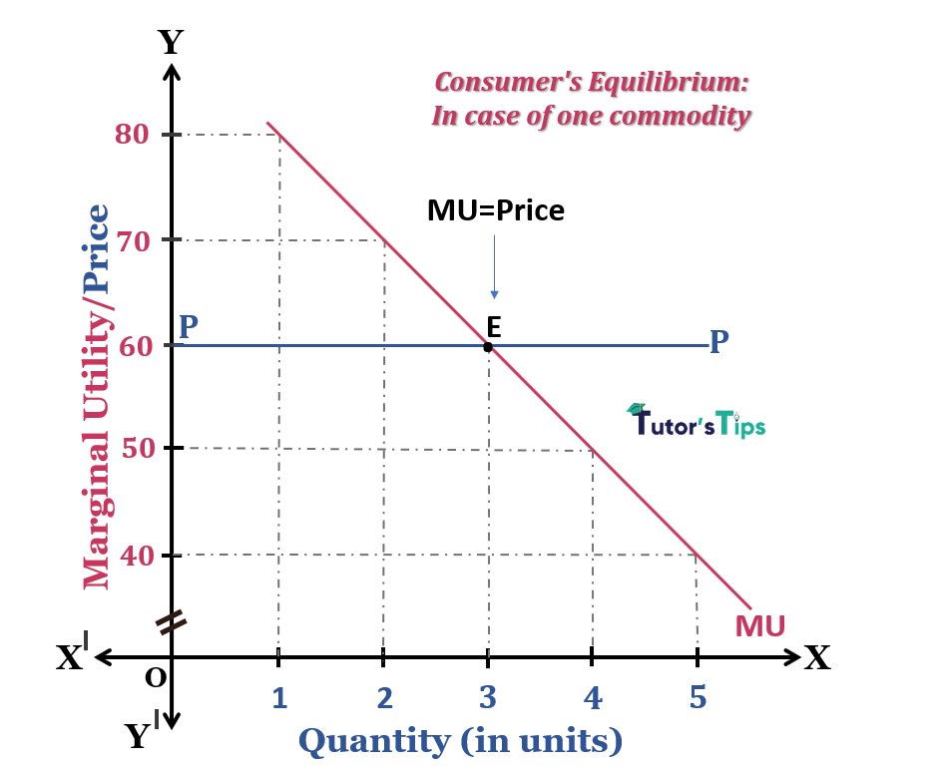
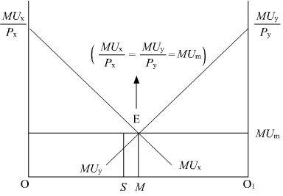

Slide 27
Criticism of Cardinal Utility Analysis
1) Consumer is not rational
2) Cardinal measurement of utility is not possible
3) Marginal utility of money does not remain constant
4) Marginal utility cannot be estimated in all conditions
5) Money is not a satisfactory measure of utility
6) Every product is not an independent product or utility analysis ignored cross effect.
7) Utility analysis has to many assumptions
8) Man is not a calculating machine or computer.
9) No distinction between income effect and substitution effect.
10) Utility analysis does not explain Geffen paradox.

Slide 28
Derivation of Demand Curve under Cardinal Approach
Dr. Alfred Marshall derived the demand curve with the help of law of diminishing marginal utility. The law of diminishing marginal utility states that as the consumer purchases more and more units of a commodity, he gets less and less utility from the successive units of the expenditure. At the same time, marginal utility of money is constant and the consumer get equilibrium when, MUX = MUm .
A rational consumer, before, while purchasing a commodity compares the price of the commodity which he has to pay with the utility of a commodity he receives from it. So long as the marginal utility of a commodity is higher than its price (MU x > P x ), the consumer would demand more and more units of it till its marginal utility is equal to its price MU x = P x or the equilibrium condition is established. To put it differently, as the consumer consumes more and more units of a commodity, its marginal utility goes on diminishing. So it is only at a diminishing price at which the consumer would like to demand more and more units of a commodity as the consumer purchases more and more units of one commodity, then lesser and lesser amount of money is left with him to buy other goods and services. If it is express in graph we can get a demand curve as below.

Slide 29
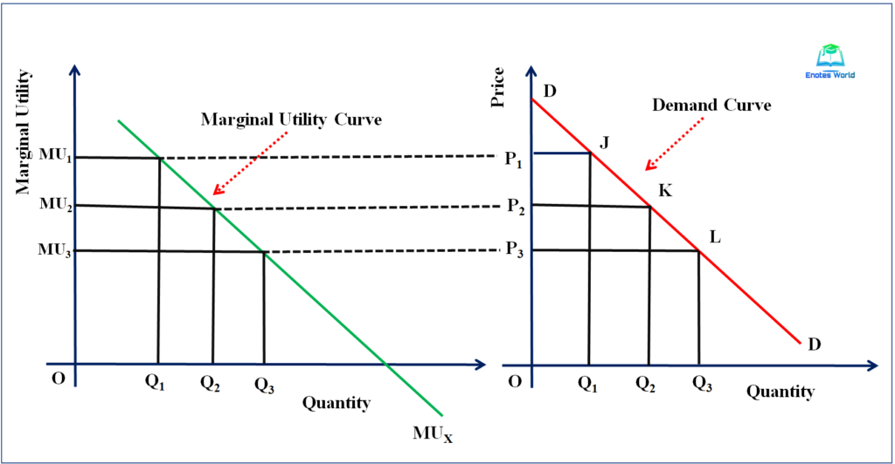

Slide 30
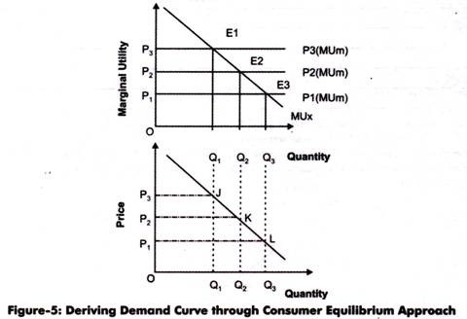

Slide 31
Ordinal Utility Analysis or Indifference curve Analysis
The modern economist, Hicks have applied the ordinal utility concept to study the consumer behavior. The Ordinal Utility approach is based on the fact that the utility of a commodity cannot be measured in absolute quantity, but however, it will be possible for a consumer to tell subjectively whether the commodity derives more or less or equal satisfaction when compared to another. The modern economist mention that the utility being the psychological phenomena it cannot be measured theoretically, quantitatively and even cardinally.
According to ordinal approach consumer behavior can explain in terms of his preference or ranking for different combinations
The modern economist introduced a tool of analysis called “Indifference Curve” to analyze the consumer behavior. An indifference curve refers to the locus of points each showing different combinations of two substitutes which yield the same level of satisfaction and utility to the consumer.

Slide 32
Assumptions of Ordinal Utility or Indifference curve Approach
Rationality: It is assumed that the consumer is rational who aims at maximizing his level of satisfaction for given income and prices of goods and services, which he wish to consume. He is expected to take decisions consistent with this objective.
Ordinal Utility: The indifference curve assumes that the utility can only be expressed ordinally . This means the consumer can only tell his order of preference for the given goods and services.
Transitivity and Consistency of Choice: The consumer’s choice is expected to be either transitive or consistent. The transitivity of choice means, if the consumer prefers commodity X to Y and Y to Z, then he must prefer commodity X to Z. In other words, if X= Y, Y = Z, then he must treat X=Z. The consistency of choice means that if a consumer prefers commodity X to Y at one point of time, he will not prefer commodity Y to X in another period or even will not consider them as equal.
Diminishing Marginal Rate of Substitution (MRS): The marginal rate of substitution refers to the rate at which the consumer is ready to substitute one commodity (A) for another commodity (B) in such a way that his total satisfaction remains unchanged. The MRS is denoted as DB/DA. The ordinal approach assumes that DB/DA goes on diminishing if the consumer continues to substitute A for B.
Non satiety: It is assumed that the consumer has not reached the saturation point of any commodity and hence, he prefers larger quantities of all commodities.

Slide 33
Explanation of Indifference Curve Analysis
Indifference Schedule And Indifference Curve Derivation
An Indifference Curve is drown from the Indifference Schedule of consumer. An indifference schedule is a list of combination of two commodities, the list being so arranged that a consumer is indifferent to the combinations, preferring none of them to any of other. Thus, an indifference schedule may be defined as a schedule of various combinations of two goods that will be equally acceptable to the consumer. Now , we will construct an imaginary indifference schedule of a consumer for the purpose of drawing an indifference curve.
Combinations Good X Good Y MRS (Dy/Dx)Ratio
A 1 20 --
B 2 15 5 1:5
C 3 11 4 1: 4
D 4 8 3 1: 3
E 5 6 2 1:2
F 6 5 1 1: 1
G 8 4 -2 1: 0.5
H 12 3 -4 1:0.25

Slide 34
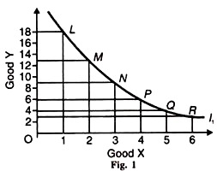
Indifference Curve Definition
The Indifference Curve shows the different combinations of two goods that give equal satisfaction and utility to the consumers. In other words, the indifference curve is the graphical representation of different combinations of
goods (generally two), for which the consumers are indifferent, in terms of the overall satisfaction and the utility. An indifference curve is a curve that represents all the combinations of goods that give the same satisfaction to the consumer. Since all the combinations give the same amount of satisfaction, the consumer prefers them equally. Hence the name indifference curve.

Slide 35
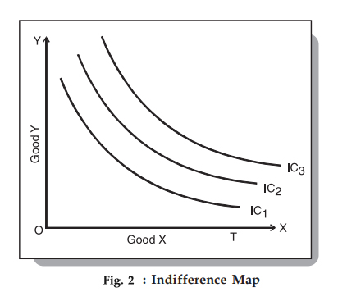
Indifference Map
An Indifference Map is a set of Indifference Curves. It depicts the complete picture of a consumer’s preferences. The following diagram showing an indifference map consisting of three curves: We know that a consumer is indifferent among the combinations lying on the same indifference curve. However, it is important to note that he prefers the combinations on the higher indifference curves to those on the lower ones. This is because a higher indifference curve implies a higher level of
satisfaction. Therefore, all combinations on IC1 offer the same satisfaction, but all combinations on IC2 give greater satisfaction than those on IC1.

Slide 36
Properties of an Indifference Curve
1) A higher Indifference Curve to the right of another represents a higher level of satisfaction and preferable combination of two goods..
2) The slope of Indifference Curve in negative downward slopping from left to right
3) The Indifference Curves are convex to the origin . The convexity rule implies that as the consumer substitute X for Y the marginal rate of Substitution diminishes. But if these two goods are perfectly Substitutable then indifference curve seems to straight line downward from left to right, on the other hand if these two goods are closely complimentary then Indifference Curve seems to L shape.
4) Indifference Curves cannot touch X axis or Y axis and they neither touch nor intersect each other.
5) Indifference Curves are not necessarily parallel to each other

Slide 37
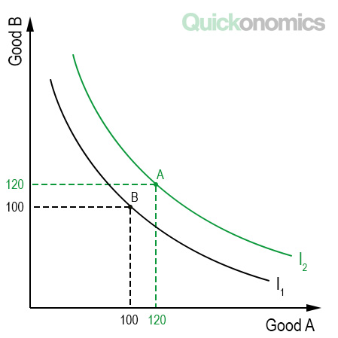
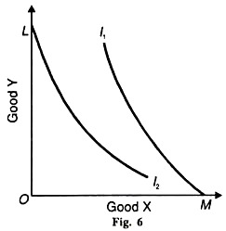
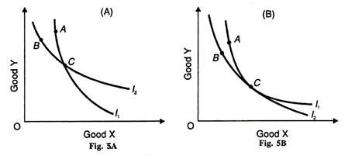
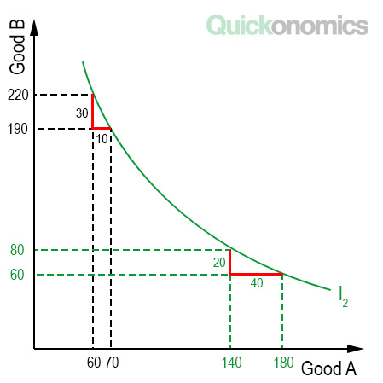
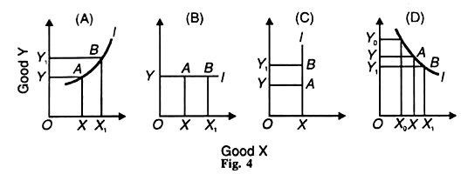
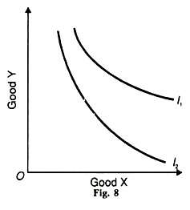

Slide 38
Marginal Rate of Substitution (MRS)
In economics, the marginal rate of substitution (MRS) is the amount of one good that a consumer is willing to give up in exchange for a new good, while maintaining the same level of utility or satisfaction, MRS is used in indifference Curve to analyze consumer behavior. When someone is indifferent to substituting one item for another, their marginal utility for substitution is zero since they neither gain nor lose any satisfaction from the trade. The marginal rate of substitution (MRS) measures the willingness of a consumer to replace one good for another good, as long as the same satisfaction—or utility—is maintained. The slope of this curve represents quantities of good X and good Y that a consumer would be happy substituting for one another.
MRS xy ​= dy/dx ​= Muy ​/ MUx​​
where:
x,y = two different goods
dx/dy ​= derivative of y with respect to x
MU = marginal utility of good x, y​
In other words, the MRS is the slope of the indifference curve at any given point along the curve and displays a frontier of utility for each combination of "good X" and "good Y.“ When the law of diminishing MRS is in effect, the MRS forms a downward, negative sloping, convex curve showing more consumption of one good in place of another.

Slide 39
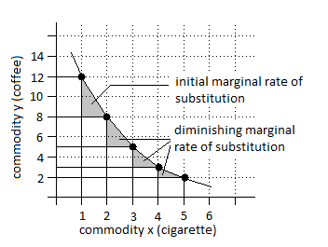
MRS is the slope of the indifference curve at any single point along the curve. The slope will often be different as one moves along an indifference curve. Most indifference curves are usually convex because, as you consume more of one good, you will consume less of the other. The value of the MRS is equal to the slope of the indifference curve drawn for the two products.
combinations Good X Good Y MRS Ratio Utility level
(Dy/Dx)
A 1 20 -- 100
B 2 15 5 1:5 100
C 3 11 4 1: 4 100
D 4 8 3 1: 3 100
E 5 6 2 1:2 100
F 6 5 1 1: 1 100
G 8 4 -2 1: 0.5 100
H 12 3 -4 1:0.25 100

Slide 40
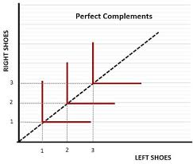
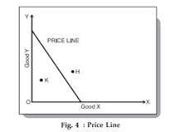
"L" shaped indifference curve
An indifference curve is the curve at every point of which the utility would remain same. The indifference curve of perfect complementary goods is ‘L’ shaped.
Let us consider this example-
‘Left shoe’ and ‘Right shoe’ can be considered as perfect complimentary goods. This is because the utility of Left shoe would be zero without a Right shoe and vice versa.
So, we have the following combinations of Left shoe and Right shoe and every combination would give us the same utility.
Combinations Left shoe Right shoe - Combinations Left shoe Right shoe
A 1 1 - F 1 1
B 1 2 - G 2 1
C 1 3 - H 3 1
D 1 4 - I 4 1
E 1 5 - J 5 1
Two commodities are perfect substitutes for each other –where MRS is constant, In this case, the indifference curve is a straight line,

Slide 41
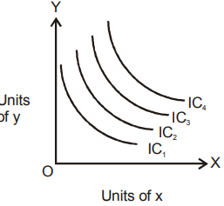
Consumer’s Equilibrium and Indifference Curve Analysis
A consumer is said to be in equilibrium when he has derived maximum satisfaction and does not want to change his consumption level. Hence, Consumer’s Equilibrium is a situation in which a consumer has maximum satisfaction with limited income and does not tend to change his existing way of expenditure. The point of equilibrium or maximum satisfaction is achieved by the study of the Indifference Map and Budget Line together.
An Indifference Map represents every possible indifference curve that the consumer has, which helps in ranking their preferences. The combination of goods on the higher indifference curve gives a higher satisfaction level to the consumer. Therefore, the highest of the indifference curves of an indifference map is preferred by a consumer.

Slide 42
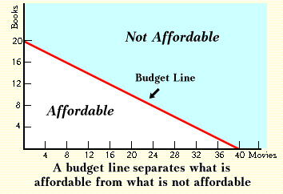
Budget Line
The term Budget Line refers to a graphical representation of all the potential combinations of two commodities that can be bought within a certain income and price, and all of these combinations provide the same satisfaction level. It comes with the condition that the cost of each combination must be less than or equal to the consumer’s money income. Simply put, a budget line is the locus of various combinations of two goods a consumer consumes and whose cost is equal to his income. Other names of Budget Line are Price Line, Price Opportunity Line, Budget Constraint Line, or Price Income Line.

Slide 43
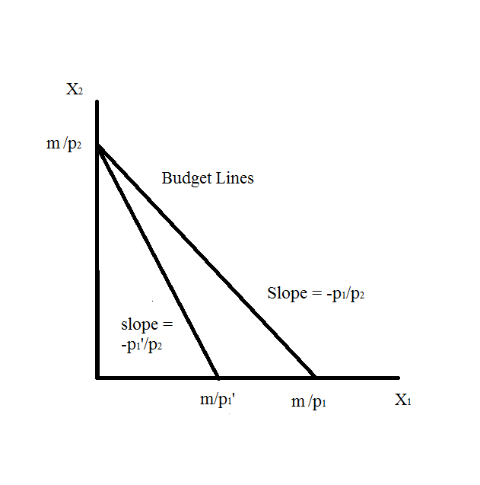
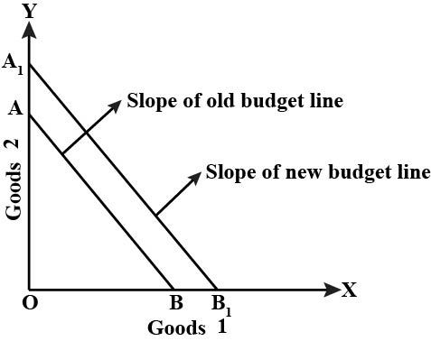
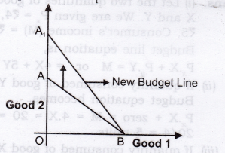
Shift in the Budget Line
There is a shift in the budget line when there is a change in the income of the consumer or when there is a change in the prices of either one or both commodities.
Effect of a Change in the Income of Consumer
Change in Prices of both Commodities
Change in the Price of Commodity on the Y-axis (Good Y)
Change in the Price of Commodity on the X-axis (Good X)

Slide 44
Consumer’s Equilibrium and Indifference Curve Analysis
A consumer is said to be in equilibrium when he has derived maximum satisfaction and does not want to change his consumption level. Hence, Consumer’s Equilibrium is a situation in which a consumer has maximum satisfaction with limited income and does not tend to change his existing way of expenditure. The point of equilibrium or maximum satisfaction is achieved by the study of the Indifference Map and Budget Line together.
In other words the term consumer’s equilibrium refers to the amount of goods and services which the consumer may buy in the market given his income and given prices of goods in the market". The aim of the consumer is to get maximum satisfaction from his money income. Given the price line or budget line and the indifference map "A consumer is said to be in equilibrium at a point where the price line is touching the highest attainable indifference curve from below “ Consumer equilibrium refers to a situation, in which a consumer derives maximum satisfaction, with no intention to change it and subject to given prices and his given income. The point of maximum satisfaction is achieved by studying indifference map and budget line together.

Slide 45
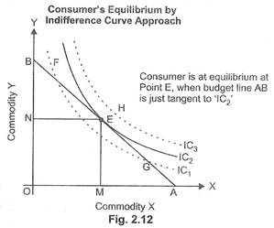
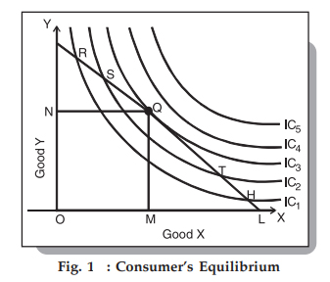

Slide 46
Consumer’s Equilibrium, Income Effect and ICC curve
Income effect express how a change in the consumer’s income influences his total satisfy action. We can define income effect as the effect caused by changes in consumer’s income on his purchases and satisfaction while prices of commodities remaining the same. When a consumer’s income increases, his budget line shifts parallel and upward and when his income decreases the budget line shifts downward. As the income changes, a new equilibrium is established and the consumer moves from one equilibrium point to another. Such movements show the rise and fall in the consumption basket. This is termed “income effect”.
In given figure, with given prices and a given money income as indicated by the budget line P₁L₁, the consumer is initially in equilibrium at Q₁ on the indifference curve IC₁ and is having OM₁ of X and ON, of Y. Now suppose that income of the consumer increases. With his increased income, he would be able to purchase larger quantities of both the goods. As budget line shift upward and parallel to the original budget line P₁L₁. Let us assume that the consumer’s money income increases by such an amount that the new budget line is P₂L₂ (consumer’s income has increased by L₁L₂ in terms of X or P₁P₂ in terms of Y). With budget line , P₂L₂ the consumer is in equilibrium at Q₂ on indifference curves IC₂ and is buying OM₂ of X and ON₂ of Y. and so on,

Slide 47
Thus, as a result of the increase in his income the consumer buys more quantity of both the goods. Since he is on the higher indifference curve IC₂he will be better off than before i.e., his satisfaction will increase. As the consumer’s income increases, he switches to higher indifference curves and as a consequence enjoys higher levels of satisfaction If now various points Q₁, Q₂, Q₃ and Q₄ showing consumer’s equilibrium at various levels of income are connected together, we will get what is called Income Consumption Curve (ICC). Income consumption curve is thus the locus of equilibrium points at various levels of consumer’s income. Income consumption curve traces out the income effect on the quantity consumed of the goods. Income effect can either be positive or negative . Nature of ICC curve depends on the nature of goods consumed by the consumer.
If both goods are normal or superior goods then the nature of ICC curve seems to upward slopping left to right, if one of good is stable good, change in income of consumer will not change that good all the effect goes to other good at that time the nature of ICC curve will be parallel to OX axis or OY axis. But the nature of one good is Superior good and other is inferior then the nature of ICC curve became slope towards X axis or Y axis indicating that as income increase the consumption of superior good goes up and the consumption of inferior good goes down as shown in given figurers.

Slide 48
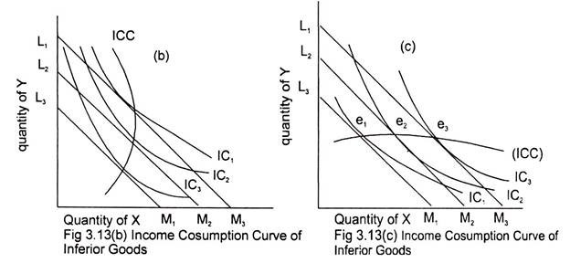
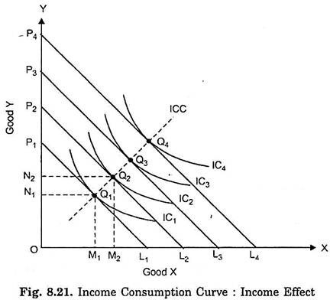
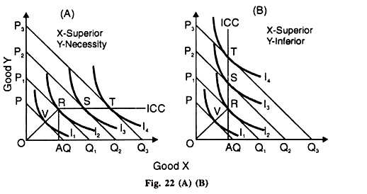
Income Effect and Nature of ICC Curves

Slide 49
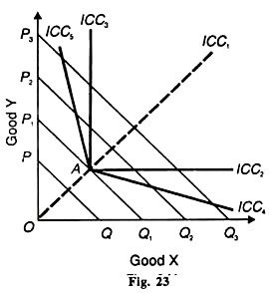
ICC curves

Slide 50
Income Effect and Example Numerical
Income of consumer Rs 10000 per month .
Product Price Demand Total Expenditure
X 200 20 4000
Y 100 60 6000
Change in income to Rs 15000 per month
Nature of Goods
1) X stable Y superior
Product Price Demand Total Expenditure
X 200 20 4000
Y 100 110 11000
2) X and Y both Superior or Normal
Product Price Demand Total Expenditure
X 200 30 6000
Y 100 90 9000
3) X Superior Y inferior
Product Price Demand Total Expenditure
X 200 50 10000
Y 100 50 5000
4) Y Superior X Inferior
Product Price Demand Total Expenditure
X 200 100 1000
Y 100 140 14000

Slide 51
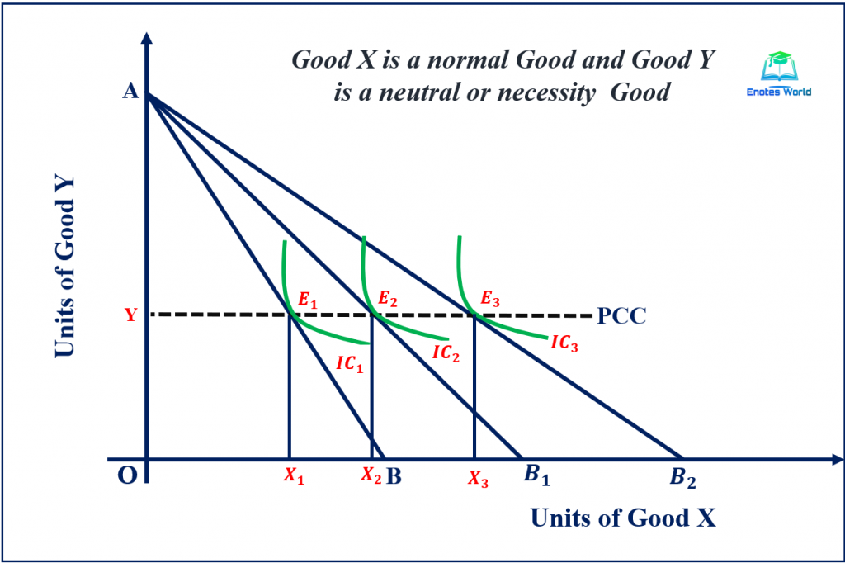
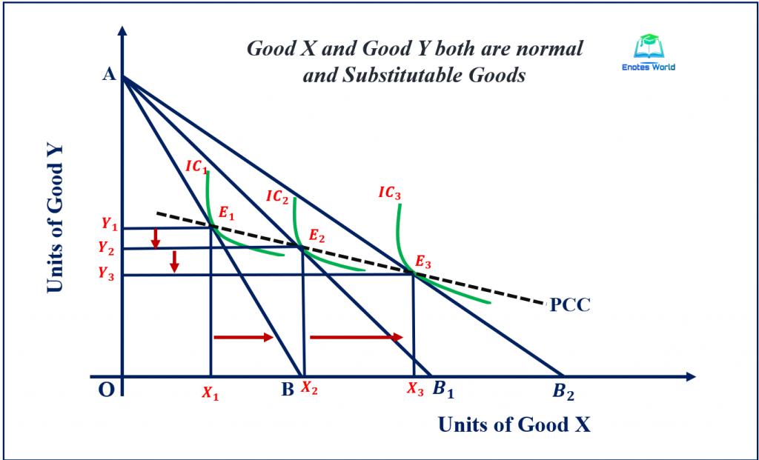
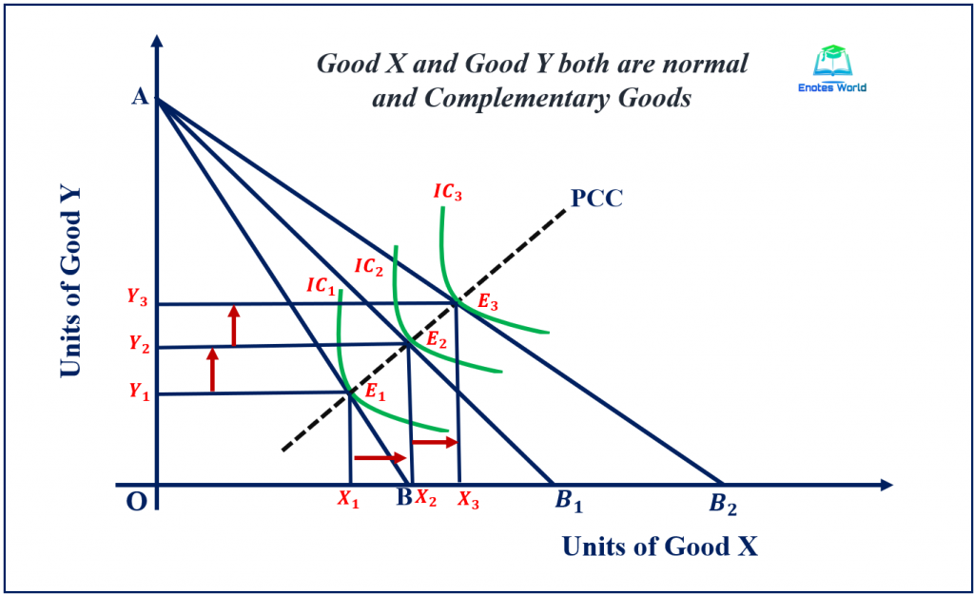
Price Effect and PCC Curve
A price effect represents change in consumer’s optimal consumption combination on account of change in the price of a good and thereby changes in its quantity purchased, price of another good and consumer’s income remaining unchanged. The consumer is better-off when optimal consumption combination is located on a higher indifference curve and vice versa. In other words, The price effect describes the condition on the consumer’s purchases for a commodity (say X good) when its price changes, given consumer's tastes & preferences, his income and the price of good Y remains constant. It shows the total effect on consumer's demand for a commodity due to the change in the price of the same commodity, other things being equal.

Slide 52
Price Effect and Example Numerical
Income of consumer Rs 10000 per month .
Product Price Demand Total Expenditure
X 200 20 4000
Y 100 60 6000
Income remain constant 10000. but price of product change
Relation of goods
1) X and Y are nonrelated Goods
Product Price Demand Total Expenditure
X 200 20 4000
Y 200 30 6000
2) X and Y both are complimentary Goods
Product Price Demand Total Expenditure
X 200 15 3000
Y 200 35 7000
3) X and Y both are Substitute Goods
Product Price Demand Total Expenditure
X 200 30 6000
Y 200 20 4000

Slide 53
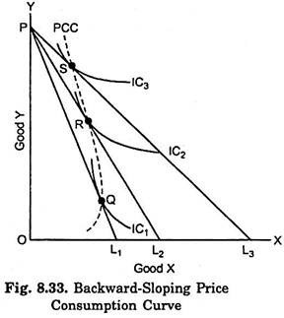
Price consumption curve can also have a backward-sloping shape, which is depicted in Fig. 8.33. Backward-sloping price consumption curve for good X indicates that when price of X falls, after a point smaller quantity of it is demanded or purchased. This is true in case of exceptional type of goods called Giffen Goods.

Slide 54
Demand Supply and Price
Meaning of demand and Law of demand
Demand in economics means a desire to possess a good supported by willingness and ability to pay for it. If you have a desire to buy a certain commodity . Demand is an effective desire, i.e., a desire which is backed by willingness and ability to pay for a commodity in order to obtain it. According to Prof. Bober, “By demand we mean the various quantities of a given commodity or service which consumers would buy in one market in a given period of time at various prices or at various incomes or at various prices of related goods.”
Demand is an economic principle referring to a consumer's desire to purchase goods and services and willingness to pay a price for a specific good or service. Market demand is the total quantity demanded across all consumers in a market for a given good Thus there are three main characteristics of demand in economics. 
(i) Willingness and ability to pay. Demand is the amount of a commodity for which a consumer has the willingness and also the ability to buy.
(ii) Demand is always at a price. If we talk of demand without reference to price, it will be meaningless. The consumer must know both the price and the commodity. He will then be able to tell the quantity demanded by him.
(iii) Demand is always per unit of time. The time may be a day, a week, a month, or a year.
Summing up, we can say that by demand is meant the amount of the commodity that buyers are able and willing to purchase at any given price over some given period of time. Demand is also described as a schedule of how much a good people will purchase at any price during a specified period of time

Slide 55
Individual Demand, market demand and Demand Schedules
Individual Demand implies the quantity demanded of a commodity by a single potential consumer, firm, or household, at different price levels, and during a given period at given market. In other words, the quantity of a commodity a consumer is willing and able to purchase at every possible price during a specific time period in a specific market is known as Individual Demand.
Market Demand implies the sum total of all individual demand for the commodity at each possible price, over a period of time at given Market. In other words, the quantity of a commodity that all consumers are willing and able to purchase at every possible price during a specific time period in a specific market is known as Market Demand . Market demand for a commodity refers to the aggregate quantity of the commodity demanded by all the potential consumers in the market at different price levels, over a certain period

Slide 56
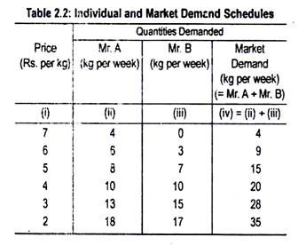
An individual demand schedule is a tabular representation of the list of quantities of a commodity demanded by an individual at different price levels, during a certain period of time
A market demand schedule is a tabular representation indicating how much quantity of a commodity the consumers are willing and able to buy in a market at different prices, during a specified period of time. Basically, it is a sum of the individual demand schedules, indicating the preference scale of different consumers taken together, at different price levels.

Slide 57
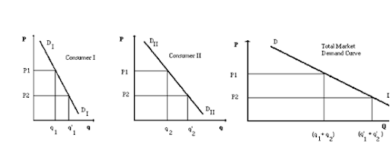
Demand Curve

Slide 58
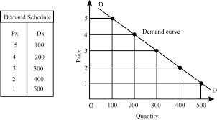
Law of Demand
The law of demand is one of the most fundamental concepts in economics. The law of demand states that the quantity purchased varies inversely with price. In other words, the higher the price, the lower the quantity demanded. This occurs because of diminishing marginal utility. That is, consumers use the first units of an economic good they purchase to serve their most urgent needs first, then they use each additional unit of the good to serve successively lower-valued ends.
Demand curve is a relation between the price and the quantity demanded of a good. The main point of this relation is that, “other things” remaining the same, if the price of a good increases or decreases, then its quantity demanded decreases or increases, respectively. This relation is known as the law of demand.

Slide 59
Demand Function
The demand function is an equation that express the relationship between the demand for a product or service as a function of its price, and other variables including income, preferences, and prices of substitutes and complements. The main thing about the demand function, is that demand for a good, apart from depending on its own price, depends on “other things” as well, e.g., income of the buyers, prices of substitute and complemen­tary goods, the tastes and habits of the buy­ers, number of buyers, etc. The influence of these “other things” on the demand for a good is also very important.
The Demand Function is a mathematical function that describes the relationship between price and quantity demanded. It is used to determine how much of a good or service consumers are willing to purchase at a given price. So in general D = f(P)
But the demand function lists out the variables that are believed to have an influence on the demand for the product .
it can be written as
Dx = f ( Px , Pr , Y , T , A , E, Gp, W, Np , F, M )
where
Dx is demand for commodity x ;
Px is price of given commodity x ;
Pr is price of related goods ;
Y is Income of the consumer ;
T denotes tastes and preferences ;
A denotes advertising ;
E denotes expectation about future prices ;
Gp denotes Government Policies
W denotes weather
Np denotes Number of Population
F denotes Fashion
M denotes all other miscellaneous factors.

Slide 60
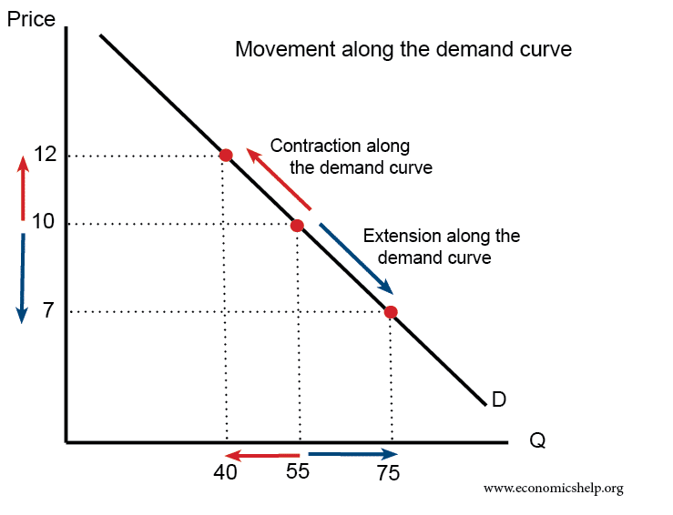
Movement on demand curve
The movement along a demand curve occurs due to a change in the price level of the goods. When the price level decreases, the demand curve moves upward or contracts towards the left side while keeping other variables constant. And as the price level decreases, the demand for the good extends to the right while other factors are constant.
Contraction in demand. An increase in price from Rs 10 to Rs12 causes a movement along the demand curve, and quantity demand falls from 55 to 40. We say this is a contraction in demand
Expansion in demand. A fall in price from Rs 10 to Rs 7 leads to an expansion (increase) in demand. As price falls, demand increase from 55 to 75 there is a movement along the demand curve and more is bought

Slide 61
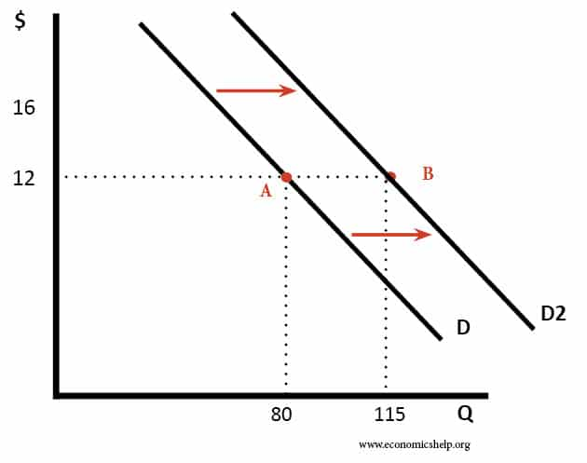
Shift of demand curve
Demand curve is a relation between the price and the quantity demanded of a good. The main point of this relation is that, “other things” remaining the same, if the price of a good increases or decreases, then its quantity demanded decreases or increases, respectively. This relation is known as the law of demand.
The main thing about the demand function, on the other hand, is that demand for a good, apart from depending on its own price, depends on “other things” as well, e.g., income of the buyers, prices of substitute and complemen­tary goods, the tastes and habits of the buy­ers, number of buyers, etc. The influence of these “other things” on the demand for a good is also very important.

Slide 62
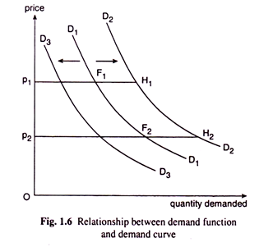
If one (or more) of these things changes, then, at any particular price, the quantity demanded of the good would also change, i.e., the demand curve for the good would shift to the right or to the left. For example, in Fig. 1.6, initially, the demand curve for a good is D₁D₁. This curve tells us that at prices p₁ and p₂, quantities demanded of the good are p₁F₁ and p₂F₂, respectively. Suppose, now there is an increase in the income of the buyers of the good.
As a consequence of this, the quantity demanded of the good that was obtained initially at any particular price, would now increase (provided the good is a normal good). After the increase in income, at the prices p₁ and p₂, the quantity demanded of the good has been p₁H₁ (> p₁F₁) and p₂H₂ (> p₂F₂), respectively. That is, now, the demand curve for the good would shift to the right from D₁D₁ to D₂D₂. Similarly, if the income of the buyers diminishes, the demand curve would shift to the left from D₁D₁ to, say, D₃D₃.

Slide 63
Supply, Supply Schedule and Law of Supply
Supply refers to the quantity of a commodity that a firm is willing and able to offer for sale at a given price during a given period of time. Supply refers to how much of a resource firm, producers, laborers, financial asset providers, and other economic agents are willing and able to deliver to the market or to an individual . It is a fundamental economic concept that describes the total amount of a specific good or service that is available to consumers. Each specific good or service will have its own supply patterns based on price, utility and personal preference.
When all other conditions are held constant, supply in the goods market refers to the amount of a product that manufacturers are willing to sell per unit of time at various prices.
A supply schedule refers to a table or spreadsheet that lists the changes in the number of goods or services the producers are willing to offer with the change in their price during a given period. It works on the principles of the law of supply and helps form a supply curve. It indicates a direct relationship between a commodity’s price and the quantity supplied
Law of supply states that other factors remaining constant, price and quantity supplied of a good are directly related to each other. In other words, when the price paid by buyers for a good rises, then suppliers increase the supply of that good in the market. The concept of the law of supply can further be illustrated by Supply Schedule and Supply Curve.

Slide 64
Supply Schedule And Supply Curve
The supply schedule is the tabular representation of the different prices of the commodity and the corresponding quantities that the suppliers are willing to offer for sale
A market supply schedule is a table that lists the various price levels of particular goods and the quantities that two or more producers or suppliers are willing to offer for sale in a given period.
Schedule of Individual Supply
Price ($) | Quantity (Kgs)
10 | 150
11 | 180
12 | 210
13 | 240
14 | 270
Price ($) | Individual Supply (kgs) |  | Market Supply (kgs) = Supplier A + Supplier B
 | Supplier A | Supplier B
10 | 70 | 80 | 150
11 | 85 | 95 | 180
12 | 100 | 110 | 210
13 | 115 | 125 | 240
14 | 130 | 140 | 270

Slide 65
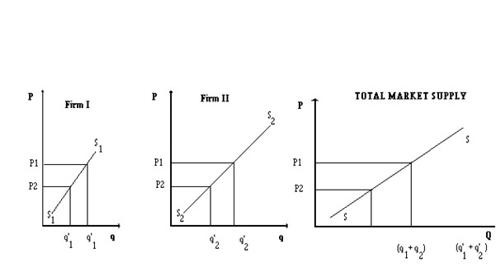
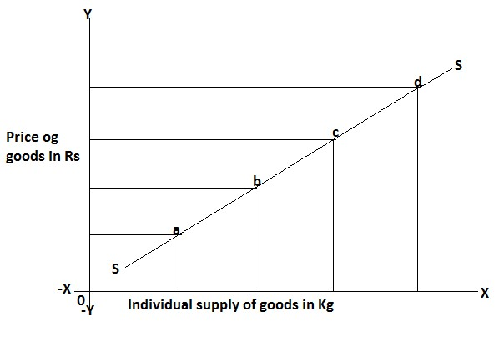
Individual and Market Supply curves

Slide 66
Supply Function and Determinants of Supply
The Law of supply expresses that when the price of a product expands or increases, its supply also increases. Likewise, when the price of a product diminishes, its supply additionally diminishes. Hence, there is an immediate connection between the price and the inventory of a product.
Supply function explains the relationship between the supply of a commodity and the factors determining its supply. We can better represent the supply function in the form of the following equation:
Sx = f (Px, Py, Pi, T, W, Gp, Fg, E ,Ms etc.)
Where,
Sx = supply of commodity x
Px = Price of commodity x
Py = Price of related good
Pi = Price of inputs
T = Technology
W = Weather conditions
Gp = Government Policy
Fg = Firm’s Goal
E = Expectation
Ms = Market structure
The factors on which the supply of a commodity depends are known as the determinants of demand. These are:
Price of the Commodity
Prices of related Commodities
Price of Inputs or Factors
Technology
Weather or Natural Factors
Government Policy
Firm Goals
Expectations
Market structure or Number of Firms

Slide 67
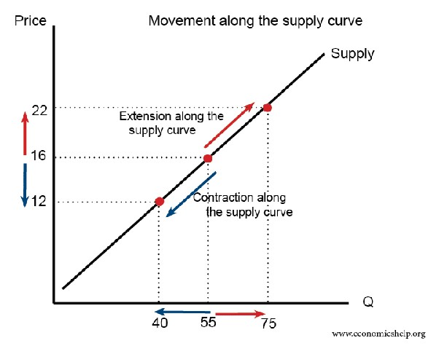
Movement Along the Supply Curve
Supply curve is a relation between the price and the quantity supplied of a good. The main point of this relation is that, “other things” remaining the same, if the price of a good increases or decreases, then its quantity supplied increases or decreases, respectively. This relation is known as the law of Supply.
The price of the product itself is not among the factors that shift the supply curve A change in price of a good or service typically causes a change in quantity supplied or a movement along the supply curve for that specific good or service, it does not cause the supply curve itself to shift.
Extension of supply It refers to the increase in supply of a commodity with the rise in price, other factors remaining unchanged.
Contraction of supply It refers to the fall in supply of a commodity when its prices fall, other factors remaining unchanged

Slide 68
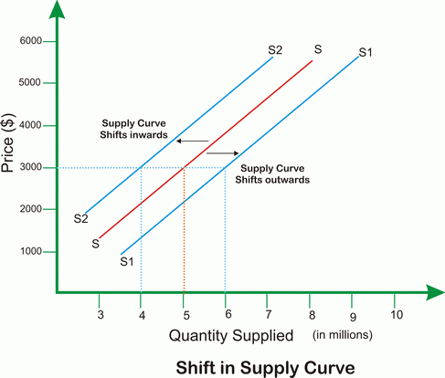
Shift of the Supply Curve
A change in supply is an economic term that describes when the suppliers of a given good or service alter production or output. A change in supply can occur as a result of change in parameters of supply such as Price of inputs, Technology Weather conditions , Government Policy etc.
.
Factors effecting the Supply
Price of the commodity
Prices related commodities
Price of inputs for production
Technological advancement
Weather of Natural factors
Government policy
Firm’s Goals
Future Expectations
Market Structure

Slide 69
Market equilibrium
A market is a place where parties can gather to facilitate the exchange of goods and services. The parties involved are usually buyers and sellers. The market may be physical, like a retail outlet, where people meet face-to-face, or virtual, like an online market, where there is no physical presence or contact between buyers and sellers.
In a market some buyers want to buy the goods but cannot find a seller, and sellers want to sell the goods but cannot find a buyer. This means that at the equilibrium price, sellers can sell exactly the quantity they want to sell at this price, and buyers can buy exactly the quantity they want to buy at this price. when the quantity demanded equals the quantity supplied, the market will be in equilibrium.
Buyers and sellers react to price changes. When prices are high, the buyer reduces consumption; when prices are low, the seller reduces production. Theoretically, in a free market condition, the demand for a product equals the supply of a product, and the price remains constant. This state is market equilibrium. A situation where for a particular good supply = demand. When the market is in equilibrium, there is no tendency for prices to change . We say the market-clearing price has been achieved.
Price of X Demand Supply
100 50 10 D > S
200 40 20 D > S
300 30 30 D = S
400 20 40 D < S
500 10 50 D < S

Slide 70
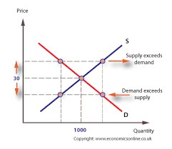
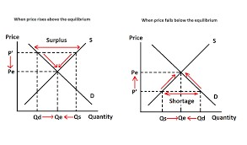
Market equilibrium

Slide 71
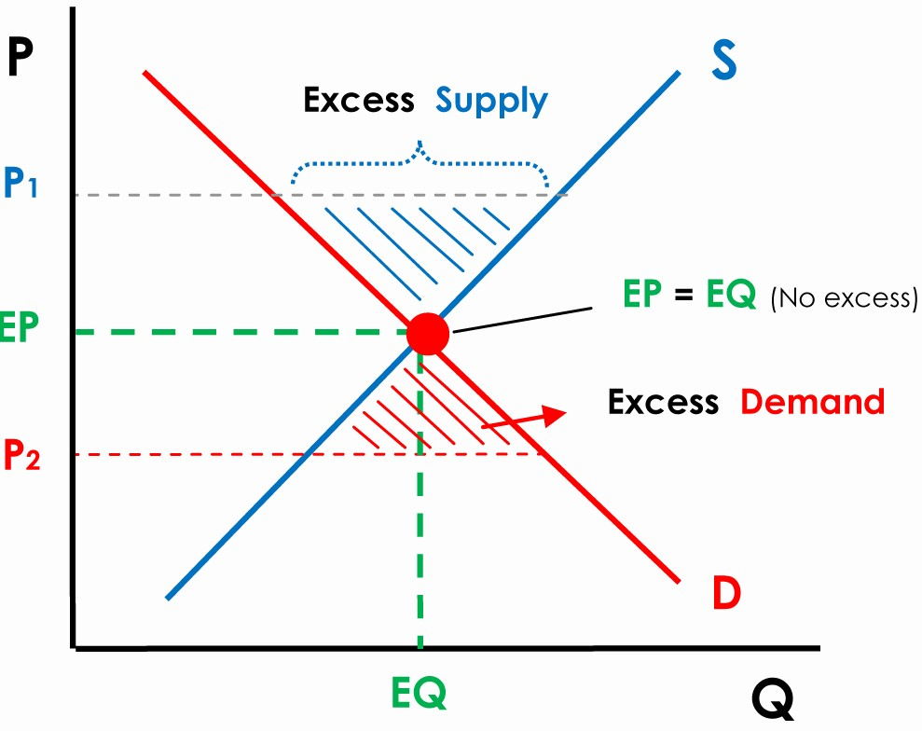
Equilibrium
The equilibrium is where the supply of goods matches demand. When a major index experiences a period of consolidation or sideways momentum, it can be said that the forces of supply and demand are relatively equal and the market is in a state of equilibrium. Equilibrium is achieved at the price at which quantities demanded and supplied are equal. We can represent a market in equilibrium in a graph by showing the combined price and quantity at which the supply and demand curves intersect.

Slide 72
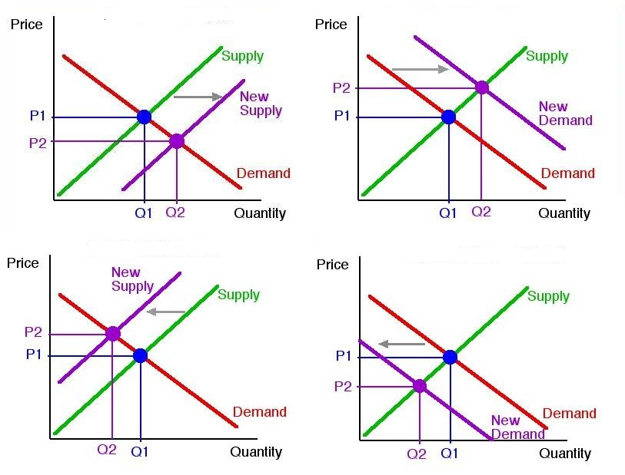
How do shifts in supply and demand curves change Equilibrium
Shifts in supply or demand curves move the equilibrium price and quantity. If demand increases, equilibrium price and quantity both increase. If demand decreases, equilibrium price and quantity both decrease.
If supply increases, equilibrium price decreases, and quantity increases. If supply decreases, equilibrium price increases and equilibrium quantity decreases. When supply and demand both shift, either price or quantity will be indeterminate.
When supply and demand move in the same direction, price is indeterminate. That is because an increase in supply decrease price while an increase in demand will increase price. Similarly, when supply and demand move in opposite directions, quantity is indeterminate because one shift will increase quantity and the other will decrease quantity.

Slide 73
Elasticity of Demand
Elasticity is the responsiveness of the quantity demanded, as a result of a change in price. When we talk about elasticity of demand we generally refer to price elasticity of demand. This is because, due to their inverse relationship, it gives a positive value. In other words, it is the rate of change in the quantity demanded with respect to the rate of change in price. Further, when it comes to the measurement of elasticity of demand, there are three methods through which we can calculate elasticity. These are:
Outlay method, or Total expenditure method.
Point Method or Geometric Method
Arc method
Elasticity of demand is an economic measure of the change in the quantity demanded or purchased of a product in relation to its price of the good or income of consumer or price of related good change. Expressed mathematically ,it is:
Price Elasticity of Demand = Percentage Change in Quantity Demanded by Percentage Change in Price
Income Elasticity of Demand = Percentage Change in Quantity Demanded by Percentage Change in Income
Cross Elasticity of Demand of X on Y = Percentage Change in Quantity Demanded of X by Percentage Change in Price of Y

Slide 74


Slide 75


Slide 76

MEASUREMENT OF PRICE ELASTICITY OF DEMAND PROPORTIONATE METHOD
This method is also given by Prof. Marshall. According to this method, price elasticity of demand is the ratio of percentage or proportionate change in demand to percentage change in price. In order to measure price elasticity of demand, the proportionate change in quantity demanded is divided with the proportionate change in the price. This method is also known as Percentage Method.
PD = 1 ( Unitary Price Elasticity Of Demand )
PD > 1 ( Elastic Price Elasticity Of Demand )
PD < 1 ( Inelastic Price Elasticity Of Demand )
PD = 0 ( Perfectly Inelastic Price Elasticity Of Demand )
PD > 100 (Perfectly Elastic Price Elasticity Of Demand )

Slide 77
Numerical questions for PED
Q1. Let suppose individual demand schedule of good x is given
Price X Rs 10 20 30 40 50
Dx Tony 160 80 40 20 0
Dx Mac 80 40 20 10 0
Dx Jone 40 20 10 0 0
Find
Market demand schedule
Market demand curve
PED when price falls from Rs 30 to 20
PED when price rises from Rs 20 to 30
Q2. Let suppose demand schedule of good Y is given
Combination A B C D E
Price Y Rs 15 16 17 18 19
Q demand 250 240 230 220 210
Find
Price elasticity from A to C
Price elasticity from C to A
Price elasticity from B to E
Price elasticity from E to B

Slide 78
PRICE ELASTICITY OF DEMAND GEOMETRIC OR POINT METHOD
This method is also given by Prof. Marshall. This method is used to measure price elasticity of demand at any point on straight line demand curve. According to this method, to measure the price elasticity of demand on any given point of a straight line demand curve, the lower part of the demand curve from that point is divided by the upper part of the demand curve. That is why thus method is also known as Point Method. This Point method is applied when there is small change in price and quantity demanded of the commodity. The method of calculating PED depends upon the nature of the demand curvePrice Price elasticity on a linear demand curve
If the demand curve is of linear nature, PED is simply calculated by applying the expression given
PED= Lower segment of Demand curve Upper segment of Demand curve
With the help of the point method, it is easy to point out elasticity at any point along a demand curve Suppose that the straight line demand curve DC in given Figure is 6 centimeters . Five points B ,C, D, E and F are taken on this demand curve The elasticity of demand at each point can be known with the help of the above method. Let point D be in the middle of the demand curve. The elasticity of demand is unity. Mov­ing up the demand curve from the mid-point, elasticity be­comes greater than one. When the demand curve touches the Y- axis, elasticity is infinity. Any point below the mid-point towards the X-axis will show inelastic demand. Elasticity becomes zero when the demand curve touches the X –axis.
.

Slide 79



Slide 80

A non linear demand curve suggests that the change in the quantity demanded due to price is not constant throughout the slope of the curve. Hence, in a non linear demand curve the slope varies with changes in quantity and price. On a non-linear demand curve, elasticity varies at different points along the curve. A non-linear demand curve is a graphical representation of the relationship between the quantity demanded of a good or service and its price, where the relationship is not a straight line. In other words, the slope of the demand curve changes as the quantity demanded changes in response to changes in price.

Slide 81


PRICE ELASTICITY OF DEMAND ARC OR AVERAGE METHOD
Arc elasticity is the elasticity of a variable in relation to another between two sets of points. This is used in the absence of any general function to define the relationship between two variables. we use arc elasticity to determine price elasticity over some part of the demand curve, instead of a single point. In finer terms, with the help of the arc method, we can compute elasticity over a range of prices Arc elasticity is a beneficial measure for assessing the elasticity of demand and supply between two points on a curve providing deep insights into the responsiveness of price or demand over a price range. Its determination involves using a midpoint between the initial and fresh rice plus quantity values, giving way to a more accurate depiction of elasticity on the whole.

Slide 82
Elasticity of Supply
The price elasticity of supply PES is a measure used in economics to show the responsiveness, or elasticity, of the quantity supplied of a good or service to a change in its price. Price elasticity of supply, is the percentage change of the quantity supplied resulting from a 1% change in price. Alternatively, PES is the percentage change in the quantity supplied divided by the percentage change in price.
When PES is less than one, the supply of the good can be described as inelastic. When price elasticity of supply is greater than one, the supply can be described as elastic. An elasticity of zero indicates that quantity supplied does not respond to a price change. If the elasticity is exactly one, the good is said to be unit-elastic.
Differing from price elasticity of demand price elasticity of supply are generally positive numbers because an increase in the price of a good motivates producers to produce more, as relative marginal revenue increases The slope of a supply curve relates changes in price to changes in quantity supplied. A steeper curve means that price changes are correlated with relatively small quantity changes. Steep supply curves derive that the quantity supplied by producers are not particularly sensitive to price changes. Oppositely, flatter supply curves imply that price changes are associated with large quantity changes. Markets with flat supply curves will see large movements in quantity supplied as prices change.

Slide 83


Slide 84


Slide 85

Consumer Surplus and Producer Surplus
The consumer surplus refers to the difference between what a consumer is willing to pay and what they paid for a product.
The producer surplus is the difference between the market price and the lowest price a producer is willing to accept to produce a good. Both consumer surplus and producer surplus are economic terms used to define market wellness by studying the relationship between the consumers and suppliers.

Slide 86
Supply And Elasticity of Supply
As the Supply refers to the quantity of a commodity that a firm is willing and able to offer for sale at a given price during a given period of time and Law of supply states that other factors remaining constant, price and quantity supplied of a good are directly related to each other. In other words, when the price paid by buyers for a good rises, then suppliers increase the supply of that good in the market.
. Elasticity is defined as a proportionate change in one variable over the proportionate change in another variable .
Price elasticity of supply measures the responsiveness to the supply of a good or service after a change in its market price. According to basic economic theory, the supply of a good will increase when its price rises. Conversely, the supply of a good will decrease when its price decreases. Price elasticity of supply is defined as the percentage change in quantity supplied caused by a given percentage change in own price of the commodity. It is measured as the ratio between the percentage change in quantity supplied and the percentage change in the price of the commodity. In other words The price elasticity of supply (PES) is the measure of the responsiveness in quantity supplied (QS) to a change in price for a specific good (% Change QS / % Change in Price).

Slide 87


Slide 88
Government Intervention with Markets
Theoretically, if left alone, a market will naturally settle into equilibrium: the equilibrium price ensures that all sellers who are willing to sell at that price, and all buyers who are willing to buy at that price will get what they want. At equilibrium, supply is exactly equal to demand. However, in some cases, the government will interfere with the market, putting in price ceilings or price floors, charging taxes, or using other measures to reshape the economy.
Price Ceilings
A price ceiling is an upper limit for the price of a good: once a price ceiling has been put in, sellers cannot charge more than that. In most cases, price ceilings are below market price. If a price ceiling is set at or above market price, there will be no noticeable effect, and the ceiling is only a preventative measure. If the ceiling is set below market price, however, there will be a shortage of goods. For instance, if the government thinks 1) that people need bread to live, and 2) that the market price of bread is too high, then they might install a price ceiling. Assume that the following graph represents the market for bread. At equilibrium, the price will be p*, and the quantity will be q*.

Slide 89

The government puts in a price ceiling, we can see that the quantity demanded will exceed the quantity supplied, meaning that not enough bread will be supplied to satisfy demand. Such a situation is called a shortage. Because price ceilings are installed in the interests of the buyers, the government has to decide which situation is preferable for the buyers: not being able to afford any bread, or not having enough bread to go around.

Slide 90

Price Floors
The opposite of a price ceiling is a price floor. A price floor is an artificially introduced minimum for the price of a good. In most cases, the price floor is above the market price. Price floors are usually put in to benefit sellers. For example, price floors are sometimes used for agricultural products. The market price can sometimes be so low that farmers cannot make enough money to support themselves. In such cases, the government steps in and sets a price floor, which can cause problems of its own:

Slide 91

TAX
Another way in which the government can alter the market is through taxes. One such example is in the tobacco market: if the government would like to discourage the sale and use of tobacco, they would charge tobacco sellers a tax on tobacco products. In most cases, sellers pass as much of the added cost on to buyers as possible. Because the sellers don't want to lose any profits, they have to increase their selling price in order to maintain the same profit margin, since they had to pay an extra tax when obtaining the products for resale. In such cases, the supply curve will shift vertically by the exact amount of the tax.

Slide 92

Subsidy
A subsidy is a benefit given to an individual, business, or institution, usually by the government. It can be direct (such as cash payments) or indirect (such as tax breaks). A subsidy is a direct or indirect payment to individuals or firms, usually in the form of a cash payment from the government or a targeted tax cut.
The subsidy is typically given to remove some type of burden, and it is often considered to be in the overall interest of the public, given to promote a social good or an economic policy.

Slide 93
Market Structure
Market structure refers to the way that various industries are classified and differentiated in accordance with their degree and nature of competition for products and services. According to economic theory, market structure describes how firms are differentiated and categorized by the types of products they sell and how those items influence their operations. A market structure helps us to understand what differentiates markets from one another.
The types of market structures include the following:
Perfect competition market
A theoretical market structure that features no barriers to entry, an unlimited number of producers and consumers, and a perfectly elastic demand curve
Imperfect competition market
Monopoly, in which there is only one provider of a product or service.
Natural monopoly, a monopoly in which economies of scale cause efficiency to increase continuously with the size of the firm. A firm is a natural monopoly if it is able to serve the entire market demand at a lower cost than any combination of two or more smaller, more specialized firms.
Duopoly, a special market with two firms
Oligopoly, in which a market is by a small number of firms that together control the majority of the market share.
Monopolistic competition, also called competitive market, where there is a large number of firms, each having a small proportion of the market share and slightly differentiated products.
Monopsony, when there is only one buyer in a market.

Slide 94
Characteristics of a perfect competition market
1) Large Number of Buyers and Sellers
2)Perfect competition with many buyers and sellers, similar products, and substitutes.
3)All parties in the market have complete and accurate information about product quality, price, and other relevant factors
4)Free Entry and Exit of Firms in the Market or Industry
5)Homogeneous Products that is every firm produces products that are identical in all respects
6)Both buyers and sellers have a perfect or full knowledge relating to the price prevailing in the market.
7)Independent Relationship between Buyers and Sellers
8)Both buyers and sellers are price takers. Because they accept the prevailing market price as given
9) Perfect Mobility of the Factors of Production and Goods The costs for transporting goods, services or factors of production from one place to another is zero or constant for all sellers.
10)Absence of Controls (free for firms up to spend on labor and capital assets without restrictions and adjust their output in relation to market demands.)
11)Absence of Transport Cost and a Close Contact between Buyers and Sellers

Slide 95

Firm and Industry in Perfect competition
A firm is different from an industry. A firm is a single unit producing or providing the market with goods and services. However, an industry is the total of all the firms manufacturing the same goods in the market The price of a product is determined by the industry at the point where the market demand curve and supply curve of the product meets, and every firm has to sell their product at this price only As there are a very large number of buyers and sellers under perfect competition, every firm is a price-taker. It means that no single firm has the ability to influence the price of a product in the market, and has to therefore sell the product at the price determined by the industry. It is so because the share of firms under perfect competition in the total market supply is negligible. Hence, it can be concluded that a firm does not play any role in the price determination of a product, as it can neither affect the supply of a product nor it can affect its demand in the market. Therefore, a firm is a Price-Taker and an industry is a Price-Maker.

Slide 96
Approaches of equilibrium of the firm
A firm can attain the equilibrium level under two different situations:
(i) When Price remains Constant (It happens under Perfect Competition). In this situation, firm has to accept the same price as determined by the industry. It means, any quantity of a commodity can be sold at that particular price.
(ii) When Price Falls with rise in output (It happens under Imperfect Competition). In this situation, firm follows its own pricing policy. However, it can increase sales only by reducing the price.
Total Revenue and Total Cost Approach(TR-TC Approach)
A firm attains the stage of equilibrium when it maximizes its profits, i.e. when it maximizes the difference between TR and TC. After reaching such a position, there will be no incentive for the producer to increase or decrease the output and the producer will be said to be at equilibrium. According to TR-TC approach, producer’s equilibrium refers to stage of that output level at which the difference between TR and TC is positively maximized and total profits fall as more units of output are produced. So, two essential conditions for producer’s equilibrium is the difference between TR and TC is positively maximized or Total profits fall after and before that level of output.

Slide 97
Approaches of equilibrium of the firm
A firm can attain the equilibrium level under two different situations:
(i) When Price remains Constant (It happens under Perfect Competition). In this situation, firm has to accept the same price as determined by the industry. It means, any quantity of a commodity can be sold at that particular price.
(ii) When Price Falls with rise in output (It happens under Imperfect Competition). In this situation, firm follows its own pricing policy. However, it can increase sales only by reducing the price.
Total Revenue and Total Cost Approach (TR-TC Approach)
A firm attains the stage of equilibrium when it maximizes its profits, i.e. when it maximizes the difference between TR and TC. After reaching such a position, there will be no incentive for the producer to increase or decrease the output and the producer will be said to be at equilibrium. According to TR-TC approach, producer’s equilibrium refers to stage of that output level at which the difference between TR and TC is positively maximized and total profits fall as more units of output are produced. So, two essential conditions for producer’s equilibrium is the difference between TR and TC is positively maximized or Total profits fall after and before that level of output.

Slide 98

Equilibrium of the Firm TR-TC Approach In Perfect Competition Market
A Firm will be determined at OQ level of output at which the vertical distance between TR and TC curves is the greatest. At this level of output, tangent to TC curve (at point G) and TR curve (at point H) and difference between both the curves (represented by distance GH) is maximum.

Slide 99
Equilibrium of the Firm TR-TC Approach In Imperfect Competition Market
Monopolist can earn maximum profits when difference between TR and TC is maximum. By fixing different prices, a monopolist tries to find out the level of output where the difference between TR and TC is maximum. The level of output where monopolist earns maximum profits is called the equilibrium situation TC is the total cost curve. TR is the total revenue curve. TR curve starts from the origin. It indicates that at zero level of output, TR will also be zero. TC curve starts from P. It reflects that even if the firm discontinues its production, it will have to suffer the loss of fixed costs . Total profits of the firm are represented by TP curve. It starts from point R showing that initially firm is faced with negative profits. Now as the firm increases its production, TR also increases. But in the initial stage, the rate of increase in TR is less than TC. Therefore, RC part of TP curve reflects that firm is incurring losses. At point M, total revenue is equal to total cost. It shows that firm is working under no profit, no loss basis. Point M is called the breakeven point. When firm produces more than point M, TR will be more than TC. TP curve also slopes upward. It shows that firm is earning profit. Now as the TP curve reaches point E then the firm will be earning maximum profits. This amount of output will be termed as equilibrium output.

Slide 100


Slide 101


Slide 102
Equilibrium of the Firm MR-MC Approach In Perfect Competition Market
MR-MC approach is a very important and useful method for determining the equilibrium of the firm. Under this approach, the following conditions must be fulfilled to attain equilibrium by the firm.
Necessary condition:- Marginal revenue should be equal to Marginal Cost i.e. MR=MC. ii. Sufficient condition:- Marginal Cost curve must intersect the Marginal Revenue curve from below.The MR-MC approach of determining equilibrium under the perfect competition and monopoly is explained as follows:-
Equilibrium of a firm under perfect competition:-
Perfect competition is characterized by a large number of buyers and sellers. Firms produce homogeneous goods and they are taken as the price takers. In this market, the firm has no control over the price. It must sell the products at that price which is determined by the industry. So, the price remains uniform. Therefore, the AR curve and MR curve are the same and parallel to X-axis. MC curve is U-shaped. The determination of equilibrium of a firm under perfect competition using this approach can be shown graphically as follows:-

Slide 103

In the figure, MR and MC represent Marginal Revenue and Marginal Cost curve. MC equals MR at point A and points E which fulfills the necessary condition. Point E fulfills both necessary and sufficient condition. So, Point 'E' is the equilibrium point and OQ2 is the equilibrium level of output.

Slide 104

Equilibrium of the Firm MR-MC Approach In Imperfect Competition Market
In the Imperfect competition market, the firm is the price maker. It can sell less output at a high price and more output at a low price. So, AR and MR curves slope downward. The MC curve is U-shaped.
The equilibrium of the firm under monopoly using MR-MC approach can be explained by the help of the diagram In the figure, MR represents the Marginal Revenue curve which is downward sloping and MC represent Marginal Cost curve which is U- Shaped. The point “b” is the equilibrium point because, at this point, MC equals MR and MC cuts MR from below. So, the firm is in equilibrium at OQ level of output and can maximize its profit.

Slide 105
Short Run Equilibrium of the Firm in Perfect Competition
Short run means period of time within which the firms can alter their level of output only by increasing or decreasing the amount of variable factors such as labour and raw material, while fixed factors, like capital equipment remain unchanged. Moreover, in the short run, new firms can neither enter the industry nor the existing firms can leave it.
All the firms are equally efficient such as they have identical cost curve.
(i) Super normal profit. (ii) Normal profit. (iii) Suffer losses
All the three situations depend upon the price determined by the industry.
A firm is in equilibrium when its marginal cost is equal to marginal revenue and marginal cost curve cuts marginal revenue curve from below. A firm in equilibrium earns super normal profits, when average revenue (Price) determined by industry is more than its average cost. In the short period, it is possible that firm earns only normal profit. This happens only when the average cost curve of the firm is tangent to its average revenue curve. A firm in equilibrium may incur losses when at the equilibrium level of output firm’s average cost is greater than average revenue.

Slide 106


Slide 107
Short Run Equilibrium of the Firm in Perfect Competition
A perpendicular parallel to the Y-axis is drawn at point E connecting the X-axis at Q. EQ is the equilibrium price of Firm A because point E lies on the demand curve, and price is determined by demand curve. Average cost is equal to AQ. Since average revenue is greater than average cost. Thus, firms per unit excess profit is EA which is the difference between price (EQ) and the corresponding average cost (AQ). Total supernormal profit of a firm is PEAC .
In case of Firm B, E is the equilibrium point because at this point MC = MR. MC curve cuts MR curve from below. 0Q is the equilibrium output. At 0Q level of output the firms AC curve is tangent to AR curve. Thus, the firm will earn only normal profit because average revenue (EQ) being equal to average cost (EQ)
The marginal cost of Firm C is equal to marginal revenue at point E. MC curve cuts MR curve from below. 0Q is the equilibrium level of output. Average revenue and average cost of the firm are equal to EQ and AQ, respectively. At 0Q level of output, firms average cost is greater than average revenue. Firm’s per unit loss is equal to EF and total loss is equal to area PEAC.

Slide 108

Short run Supply curve of a firm in perfect competition
. In a perfectly competitive market, the firms are price takers, meaning that the firms do not have the power to influence the market price. Likewise, the products that firms sell are perfectly substitutable, which means none of the firms can raise the price of their product above the price of other firms
it is very difficult for them to cover every cost incurred during the business operations. From fixed costs to variable costs, it becomes a large sum of money that is not possible to cover by the firm. In this situation, what the firm does is, only try to cover the variable costs of the business in the short run. Hence, the marginal cost of a firm at every point above the lowest average variable cost forms the short-run supply curve.

Slide 109

Long run Supply curve of a firm in perfect competition
In the long run, as there is no fixed cost, the perfectly competitive firm’s supply curve will be the summation of the upward sloping portion of SMC above the minimum point of LAC (when price ≥ minimum LAC), and the vertical portion of the price axis (when price < minimum of LAC). The long run supply curve of a perfect competitive firm is derived in two stages.
1. When price is equal to the minimum of LAC:
Let us suppose that the firm is facing market price OP that exceeds the minimum of LAC. MC is equal to MR (at point E) and MC is positively sloped at this point of intersection. Also, the price is greater than the minimum of LAC. Thus, the firm is at long run equilibrium, facing the price OP and producing Oq₁ units of output. The supply curve is ‘SS’, represented by the upward portion of LMC above the minimum of LAC.

Slide 110
Monopoly market
A market structure characterized by a single seller, selling a unique product in the market. In a monopoly market, the seller faces no competition, as he is the sole seller of goods with no close substitute . A monopoly market is one in which one firm or type of market controls a product and no one else produces or competes with it. Furthermore, a monopoly market is a type of market that features items or services that a large number of people require but no competitors.
Characteristics of Monopoly
Sole Trader
In a monopolistic market, a single seller or corporation owns the whole market and sells items that have no close substitutes. Individual sellers have total control over product supply, hence the entire market is managed by them. A monopolist is a trader or company in an industry whose whole output is reliant on them.
Price Maker
As the lone monarch of the industry, the monopolist sets the price. Because there is no other rival in the market, the seller determines the product's price. Because there is no competition, there is no one to contest the seller's pricing, which becomes the ultimate price of the goods on the market.
Barrier to Entry and Exit
A high barrier to entry/exit for new players characterizes a monopolistic market. Government licensing, copyrights and patents, resource ownership, and high beginning costs are all hurdles in a monopolistic market.
Other businesses find it difficult to enter the monopolistic market since a single provider controls the whole production and supply of a certain product.

Slide 111
Unique Product
In a monopolistic market, a firm's product or service is unique, with no near substitutes. Monopoly traders own a patent on a single product that prevents other companies from producing or selling a close equivalent.
Price Discrimination
In a monopolistic market, there is a significant risk of pricing discrimination. Without any opposition, a single trader can adjust the price of a product. He may charge various pricing to different consumers, offering greater charges to the wealthy and lower prices to the poor.
Downward Sloping Curve
The demand curve in a monopolistic market is downward sloping. It means that a company may make more money by increasing sales, which can be accomplished by lowering the product's price.
Profit Maximiser
In a monopolistic market, a company's goal is to maximize profit. Because there is no rivalry in the market, a company may charge a greater price than it would in a competitive market. As a result, the monopolistic price will be referred to as market pricing.
Stability of Product Elements
The non-movable character of all parts of production is one of the key grounds for monopolists' control over resources. No one can duplicate the production mix, therefore eliminating any prospect of a monopolist being deposed

Slide 112
Short-run Equilibrium a Firm in a Monopoly Market
The short-run equilibrium position of a firm in a monopoly. The AR line is the demand curve of a firm and the MR curve shows the marginal revenue curve of that firm. SAC represents the short-run average cost curve of firm and SMC represents the short-run marginal cost curve of a firm in a monopoly. A firm in a monopoly finds its equilibrium when marginal cost equals to average cost that is point E.
At that point, the firm will produce Q quantity at P price. The area of OQBP is the total revenue of the firm, and the area of OQAC is the total cost. The area of CABP represents the total profits of the firm in the short run, which is an abnormal profit. Another figure
. At that point E, the firm will produce Q quantity at P price. The area of OQAP is the total revenue of the firm, and the area of OQBC is the total cost. The area of PABC represents the total Loss of the firm in the short run.
But in next figure the monopoly firm get only normal profit Because according to Equilibrium point E , OQ the output is determined at OP price Where Total Revenue and Total Cost Is OQAP. As the average cost has already included the normal profit so at that time firm get normal profit in the Short run.

Slide 113



Slide 114

Long-run Equilibrium a Firm in a Monopoly Market
Long-run is that time period in which all the fixed and variable factors of production can be altered. The firm can change the size of plant and machinery and can determine the level of output to maximize its profit. Because of this, the firm does not suffer loss. Likewise, the entry of new firms is restricted somehow and the monopolist earns abnormal profit in the long run due to lack of competition. The following conditions must be fulfilled to attain equilibrium under monopoly in the long run: i) MR must be equal to LMC.
ii) LMC must intersect MR from below.
In the above figure, LAC and LMC represent long-run average cost curve and Marginal cost curve. AR and MR represent Average and Marginal Revenue. The equilibrium point is determined at ‘E’ where LMC intersects MR from below. The equilibrium level of output is determined at OQ. The cost incurred is OC and the revenue earned is OP. Since revenue is higher than cost (AR> AC), the monopolist earns abnormal profit in the long-run.

Slide 115
Monopolistic Competition Market
Monopolistic competition is a market structure where there are many small firms that produce differentiated products. Unlike perfect competition, each firm has some market power due to product differentiation, which allows them to charge slightly higher prices than their competitors. However, because there are many firms producing similar but not identical products, consumers have a range of choices and can switch to another product if the price of one becomes too high.As a result, firms in a monopolistically competitive market must engage in non-price competition, such as advertising and product differentiation, to attract customers.
Monopolistic competition occurs when many companies offer products that are similar but not identical.
Firms in monopolistic competition differentiate their products through pricing and marketing strategies.
Barriers to entry, or the costs or other obstacles that prevent new competitors from entering an industry, are low in monopolistic competition. Demand is highly elastic for goods and services of the competing companies and pricing is often a key strategy for these competitors. One company may opt to lower prices and sacrifice a higher profit margin, hoping for higher sales. Monopolistic competition is characterized by several key features: Large Number of Small Firms. There are many firms operating in the market, none of which dominates the market.
Differentiated Products. Each firm produces a product that is distinct from its competitors' products, either through quality, design, or branding.
Some Market Power. Each firm has some control over the price of its product due to product differentiation, but this control is limited because there are many substitutes available to consumers.
Non-price Competition. Firms in a monopolistically competitive market compete using advertising, product development, and other marketing strategies to attract customers rather than relying on lower prices.
These characteristics create a market structure that combines elements of both monopoly and perfect competition, resulting in a market where firms have some market power, but not enough to eliminate competition altogether.

Slide 116
Short-run Equilibrium of Individual Firm in a Monopolistic Market
In monopolistic competition, since the product is differentiated between firms, each firm does not have a perfectly elastic demand for its products. In such a market, all firms determine the price of their own products. Therefore, it faces a downward sloping demand curve. Overall, we can say that the elasticity of demand increases as the differentiation between products decreases.
The short-run equilibrium position of individual firm in a monopolistic Market. The AR line is the demand curve of a firm and the MR curve shows the marginal revenue curve of that firm. SAC represents the short-run average cost curve of firm and SMC represents the short-run marginal cost curve of a firm in a Monopolistic Market. A firm i finds its equilibrium when marginal cost equals to average cost that is point E. At that point, the firm will produce Q quantity at P price. The area of OQBP is the total revenue of the firm, and the area of OQAC is the total cost. The area of CABP represents the total profits of the firm in the short run, which is an abnormal profit. Another figure
. At that point E, the firm will produce Q quantity at P price. The area of OQAP is the total revenue of the firm, and the area of OQBC is the total cost. The area of PABC represents the total Loss of the firm in the short run.
But in next figure the monopoly firm get only normal profit Because according to Equilibrium point E , OQ the output is determined at OP price Where Total Revenue and Total Cost Is OQAP. As the average cost has already included the normal profit so at that time firm get normal profit in the Short run.

Slide 118

Long-run Equilibrium of Individual Firm in a Monopolistic Market
Long run equilibrium of a firm in monopolistic competition is achieved when marginal cost is equal to the marginal revenue which means that the change in total revenue if an additional unit of output is sold is equal to the change in total cost if an additional unit of the same output is produced and after this point the marginal must be rising and greater than marginal revenue so MC curve should cut MR curve from below. Long run marginal cost curve LMC cut the minimum point of long run average cost curve LAC and AR is equal to long run average cost which means that the firm is earning only normal profits at the long run under monopolistic competition.

Slide 119
Definitions And Characteristics of an Oligopoly
An oligopoly is a market structure with a small number of firms, none of which can keep the others from having significant influence. The concentration ratio measures the market share of the largest firms. There is no precise upper limit to the number of firms in an oligopoly, but the number must be low enough that the actions of one firm significantly influence the others. Oligopoly occurs in industries where few but large leading firms dominate the market. Firms that are part of an oligopolistic market structure can’t prevent other firms from gaining significant dominance in the market. However, as only a few firms have a significant share of the market, each firm’s behaviour can have an impact on the other.
Characteristics of an Oligopoly
1. A Few Firms with Large Market Share
A market may have thousands of sellers, but if the top 5 firms have a combined market share of over 50 percent, it can be classified as an oligopolistic market. This is because the power is concentrated between a few sellers who are able to exercise power over the market.
2. High Barriers to Entry
Oligopolistic firms maintain their position through a number of barriers to entry. For instance, brand loyalty, patents, and high start-up costs are but to name a few. These make it difficult for new entrants to build a presence in the market and attract customers. These barriers to entry make it difficult for new firms to join and sets it. As a result, these barriers to entry allow oligopolies to make higher profits due to limited competition

Slide 120
3. Interdependence of decision making
Any action a firm takes in an oligopolistic market will strongly affect the actions of its competitors. An oligopolistic firm will operate based on how they believe competitors will react. In other words, Company A expects Company X to reduce its prices, so will do so as well. This can be sub-optimal as it reduces the power of a competitive market.
4. Each Firm Has Little Market Power In Its Own Right
Leading on from interdependence; each firm has little market power, because other firms are quick to take advantage. For example, an oligopolistic firm cannot raise prices in fear that customers will flee to its competitors. One oligopolistic firm cannot dictate prices or supply because competitors are equally as ‘powerful’. On an individual basis, this keeps the firm in check.
5. Higher Prices than Perfect Competition because of advertising and selling cost
Under perfect competition, prices are just above the marginal cost, leaving firms with small profits – if any. As oligopolies have combined market power, they tend to keep prices higher to obtain larger profits.
If any firms were to reduce prices, others would also follow suit, thereby reducing profits for all. This is where it becomes tricky in distinguishing between collusion and a natural state of oligopolistic competition. Do firms naturally keep prices higher due to fear that their actions will reduce their profits? Or, do they collude to keep prices and profits high?
6. More Efficient
Oligopolistic firms benefit from high levels of market share. At the same time, they benefit from economics of scale – meaning it can produce at a lower cost. For instance, there are markets that have high fixed costs such as car manufacturers. If new competitors want to enter, they have to spend millions on new factories and other infrastructure.
Consequently, this would increase costs for existing firms as the benefit they receive from economies of scale would decline. This means higher prices for customers and it is for this reason that such markets are better served under an oligopolistic market structure.

Slide 121
A cartel is defined as a group of firms that gets together to make output and price decisions. The conditions that give rise to an oligopolistic market are also conducive to the formation of a cartel; in particular, cartels tend to arise in markets where there are few firms and each firm has a significant share of the market. Oligopolistic firms join a cartel to increase their market power, and members work together to determine jointly the level of output that each member will produce and/or the price that each member will charge. The cartel members choose their combined output at the level where their combined marginal revenue equals their combined marginal cost. The cartel price is determined by market demand curve at the level of output chosen by the cartel. A cartel is an association of independent firms within the same industry.
The cartel follows common policies relating to prices, outputs, sales and profit maximization and distribution of products
Most common types of cartels
(1) Joint profit maximization or perfect cartel; and
(2) Market-sharing cartel.
The uncertainty is found in an oligopolistic market which provides an incentive to rival firms to form a perfect cartel. Perfect cartel is an extreme form of perfect collusion. Under it, firms producing a homogeneous product form a centralized cartel board in the industry The individual firms surrender their price-output decisions to this central board. The board determines for its members the output, quotes the price to be charged and the distribution of industry profits. The central board acts like a single monopoly whose main aim is to maximize the joint profits of the oligopolistic industry.

Slide 122
Joint profit maximization cartel is based on the following assumptions
1. Only two firms A and B are assumed in the oligopolistic industry that form the cartel.
2. Each firm produces and sells a homogeneous product that is a perfect substitute for each other.
3. The market demand curve for the product is given and is known to the cartel.
4. The number of buyers is large.
5. The price of the product determines the policy of the cartel.
The cost curves of the firm’s are different but are known to the cartel.
The cartel aims at joint profit maximization.
Given these assumptions, and given the market demand curve and its corresponding MR curve, joint profits will be maximized when the industry MR equals the industry’s MC. Figure 10 shows the situation where D is the market (or cartel) demand curve and MR is its corresponding marginal revenue curve. The aggregate marginal cost curve of the industry ΣMC is drawn by the lateral summation of the MC curves of firms A and B, so the ΣMC = MC_{a} + MC_{b},. The cartel solution-that maximizes joint profit is determined at point Σ where the Σ MC curve intersects the industry MR curve. Consequently, the total output is OQ which will be sold at OP = (QF) price.

Slide 123


